Slide 1
人工智能引论
宋睿华
中国人民大学人工智能学院

Slide 2
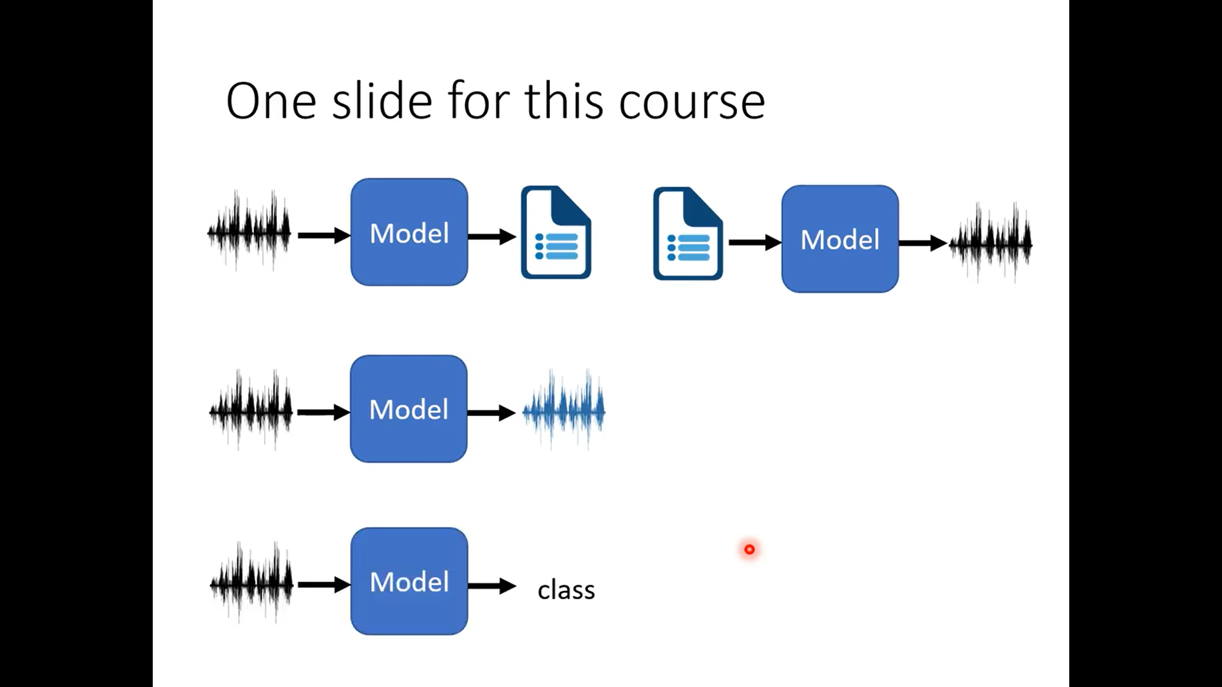

Slide 3
人工智能与听觉
听觉基础
典型的听觉任务与模型
语音识别
语音合成

Slide 4
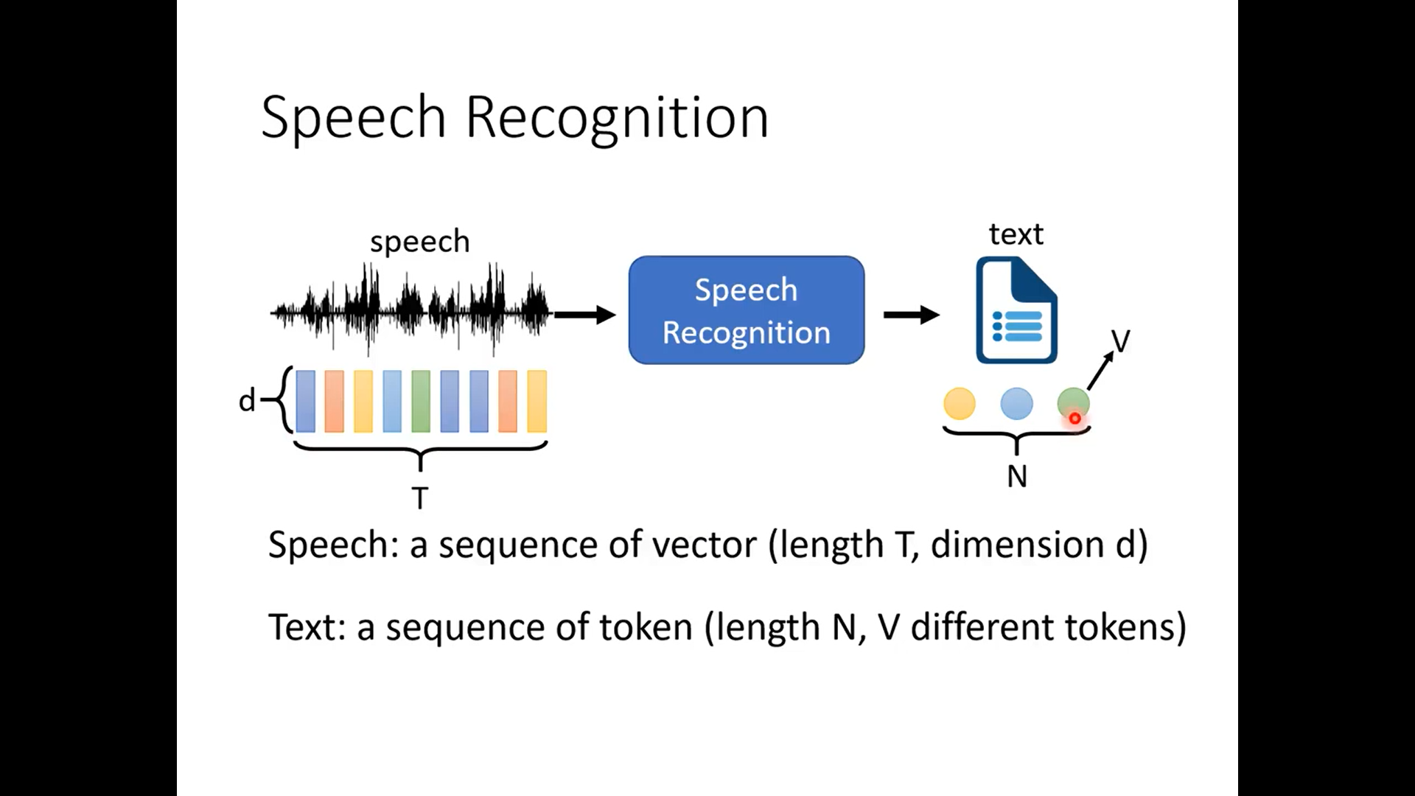

Slide 5
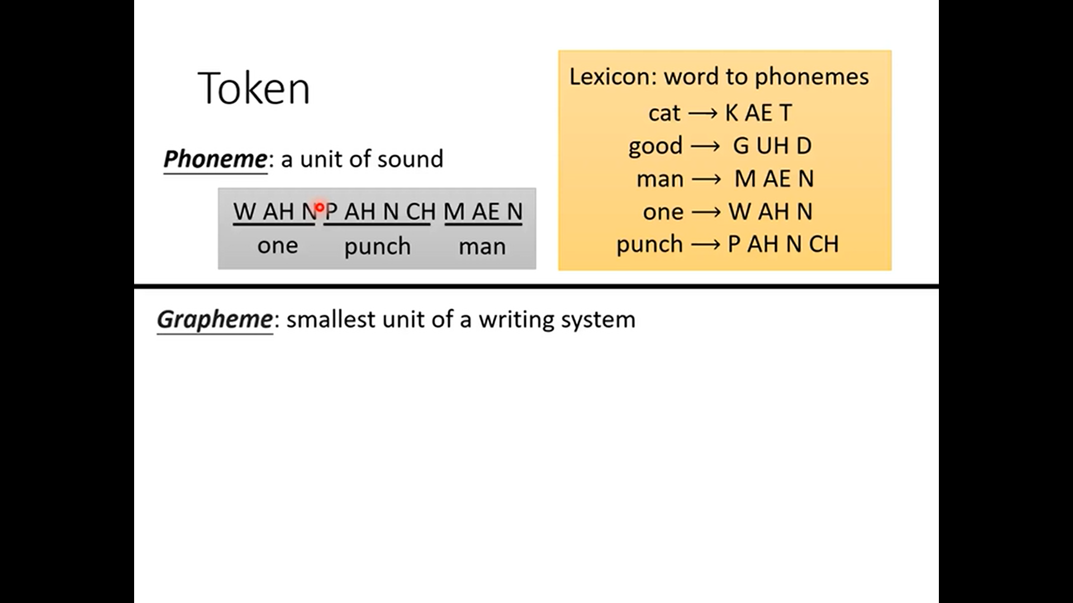

Slide 6
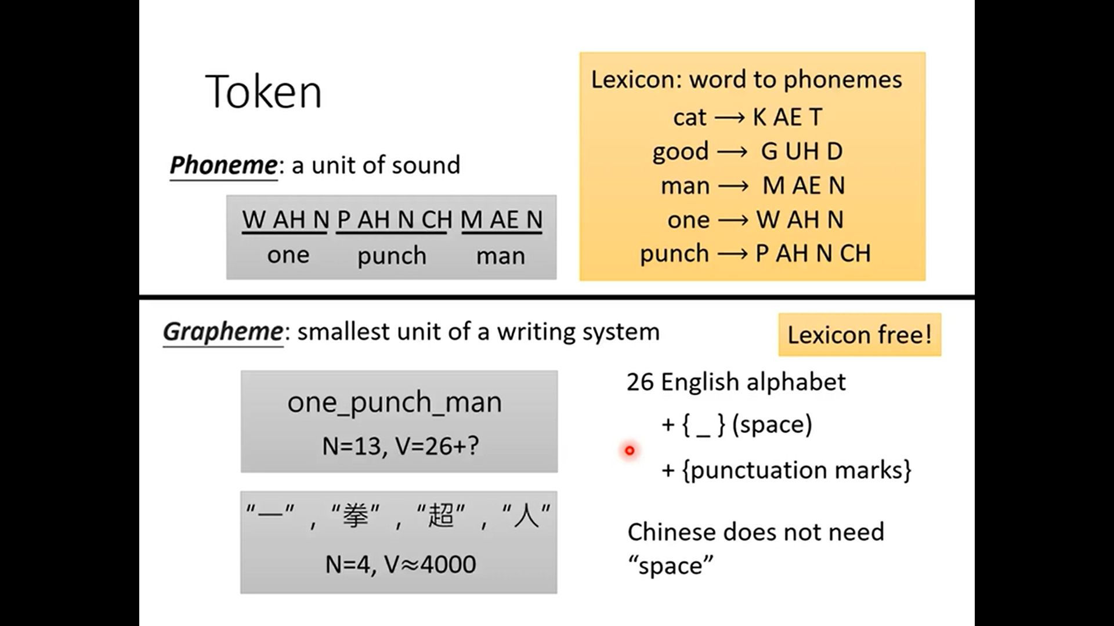

Slide 7
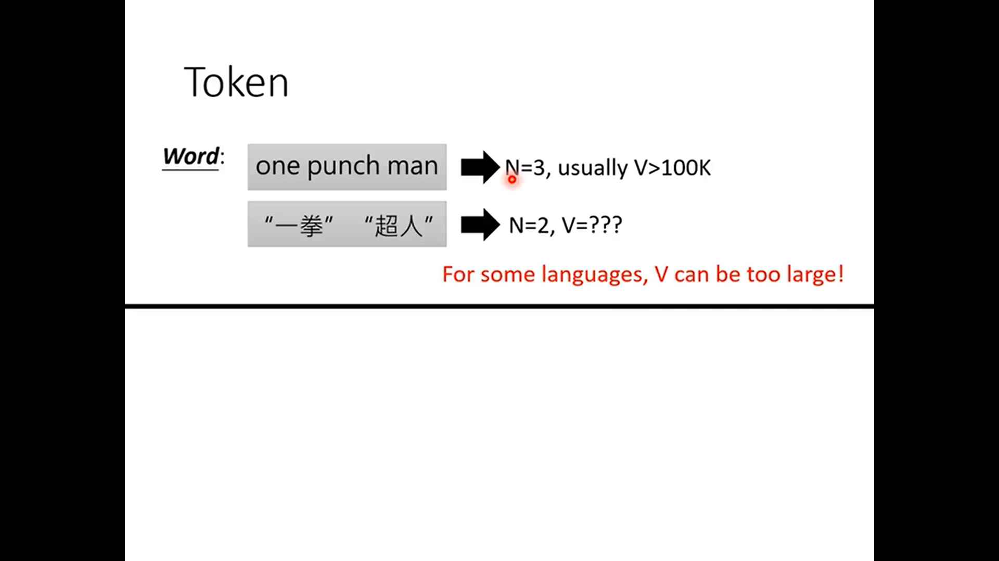

Slide 8
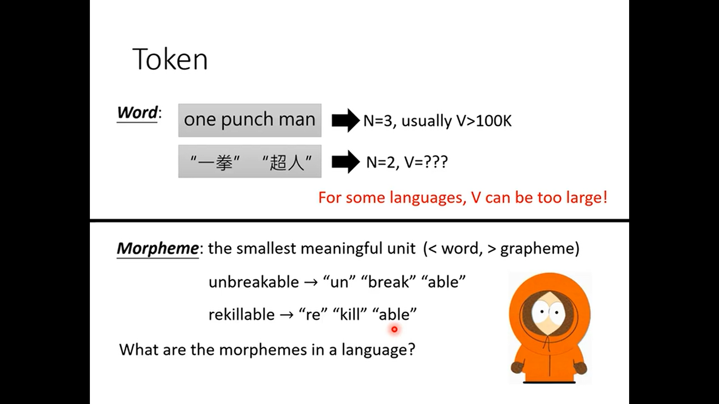

Slide 9
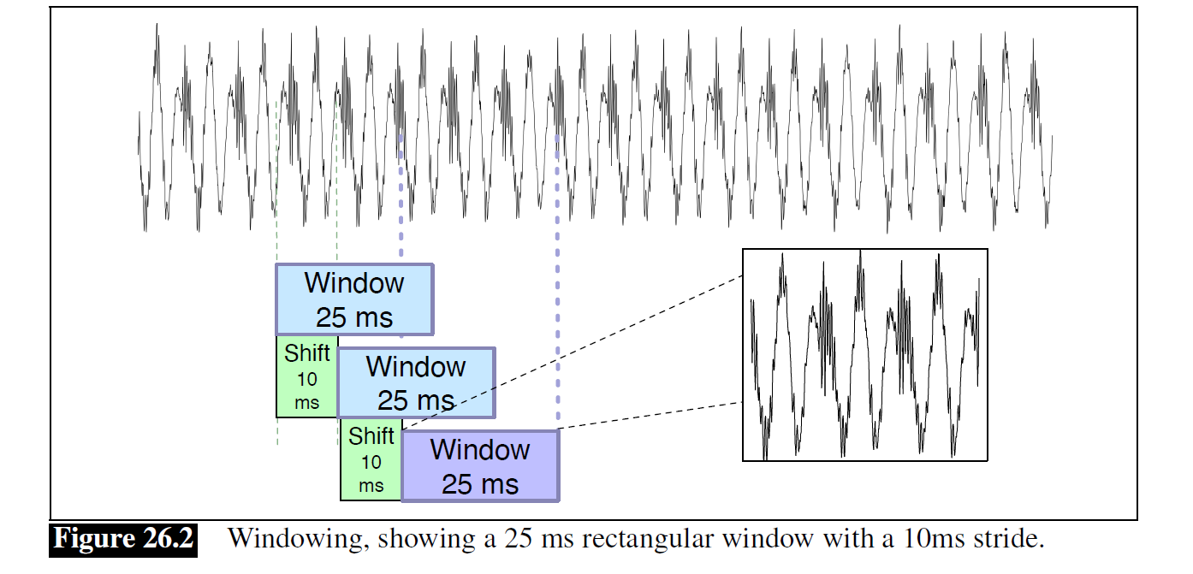
Frame or Window

Slide 10
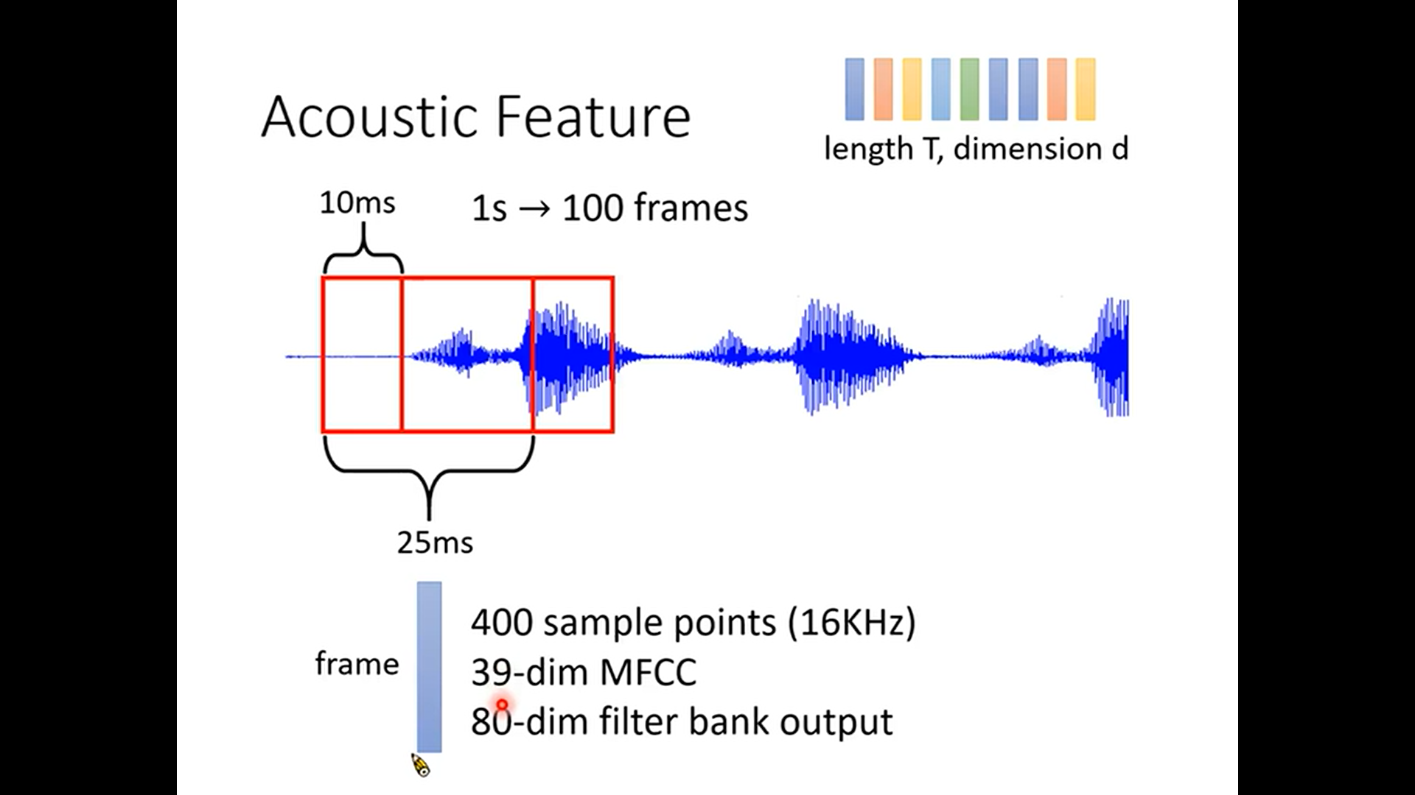

Slide 11
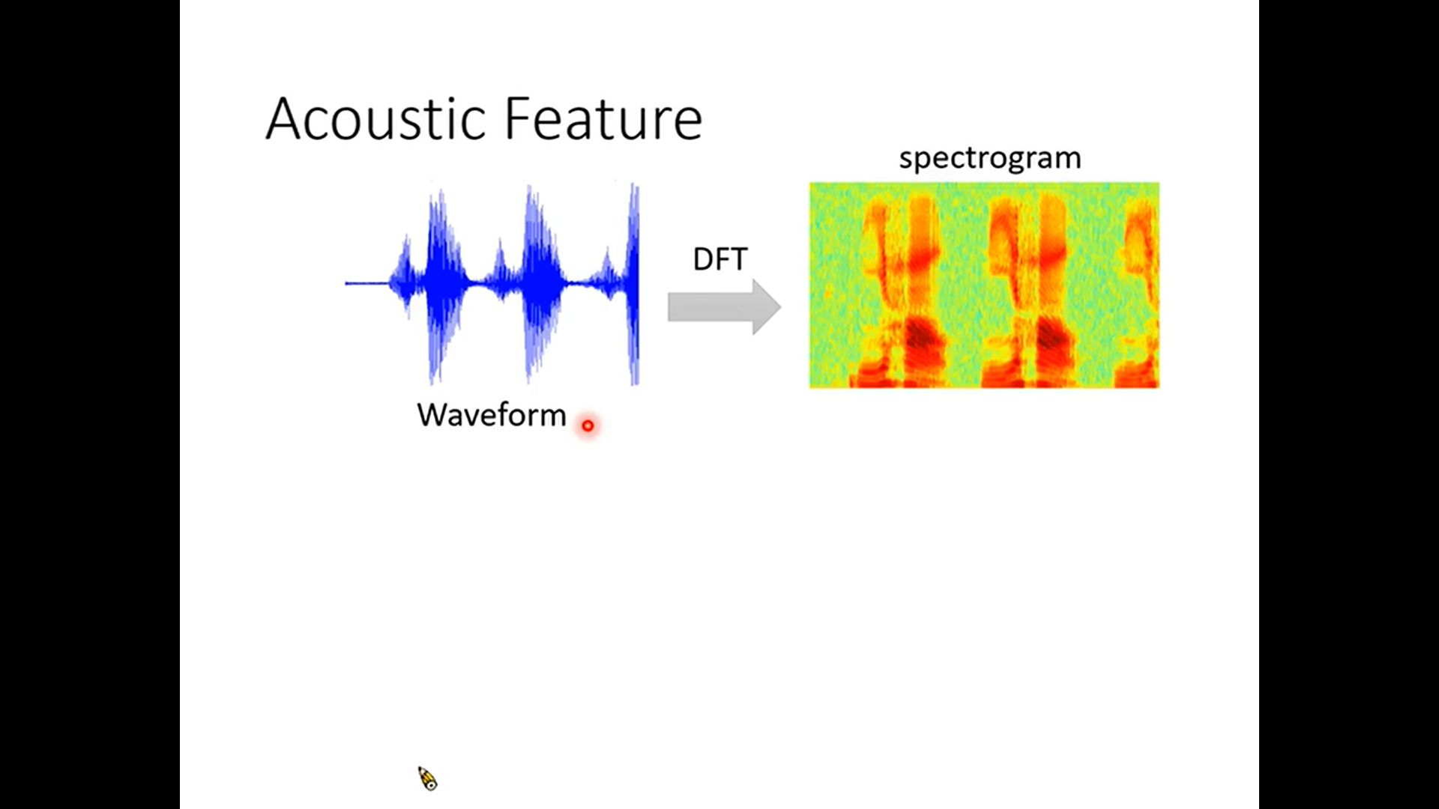

Slide 12
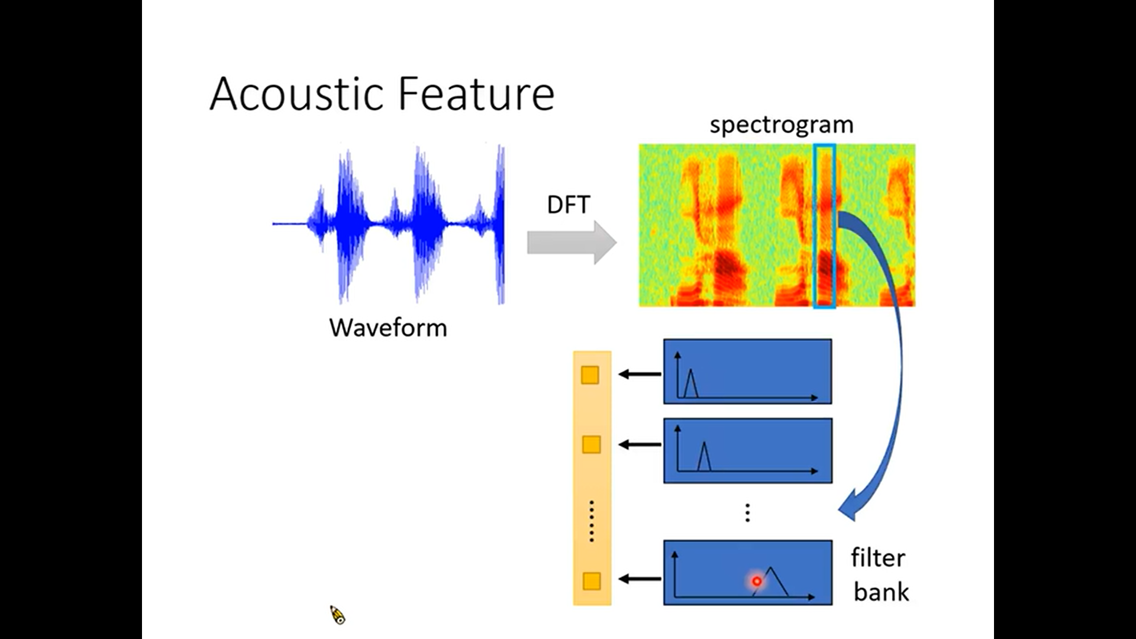

Slide 13
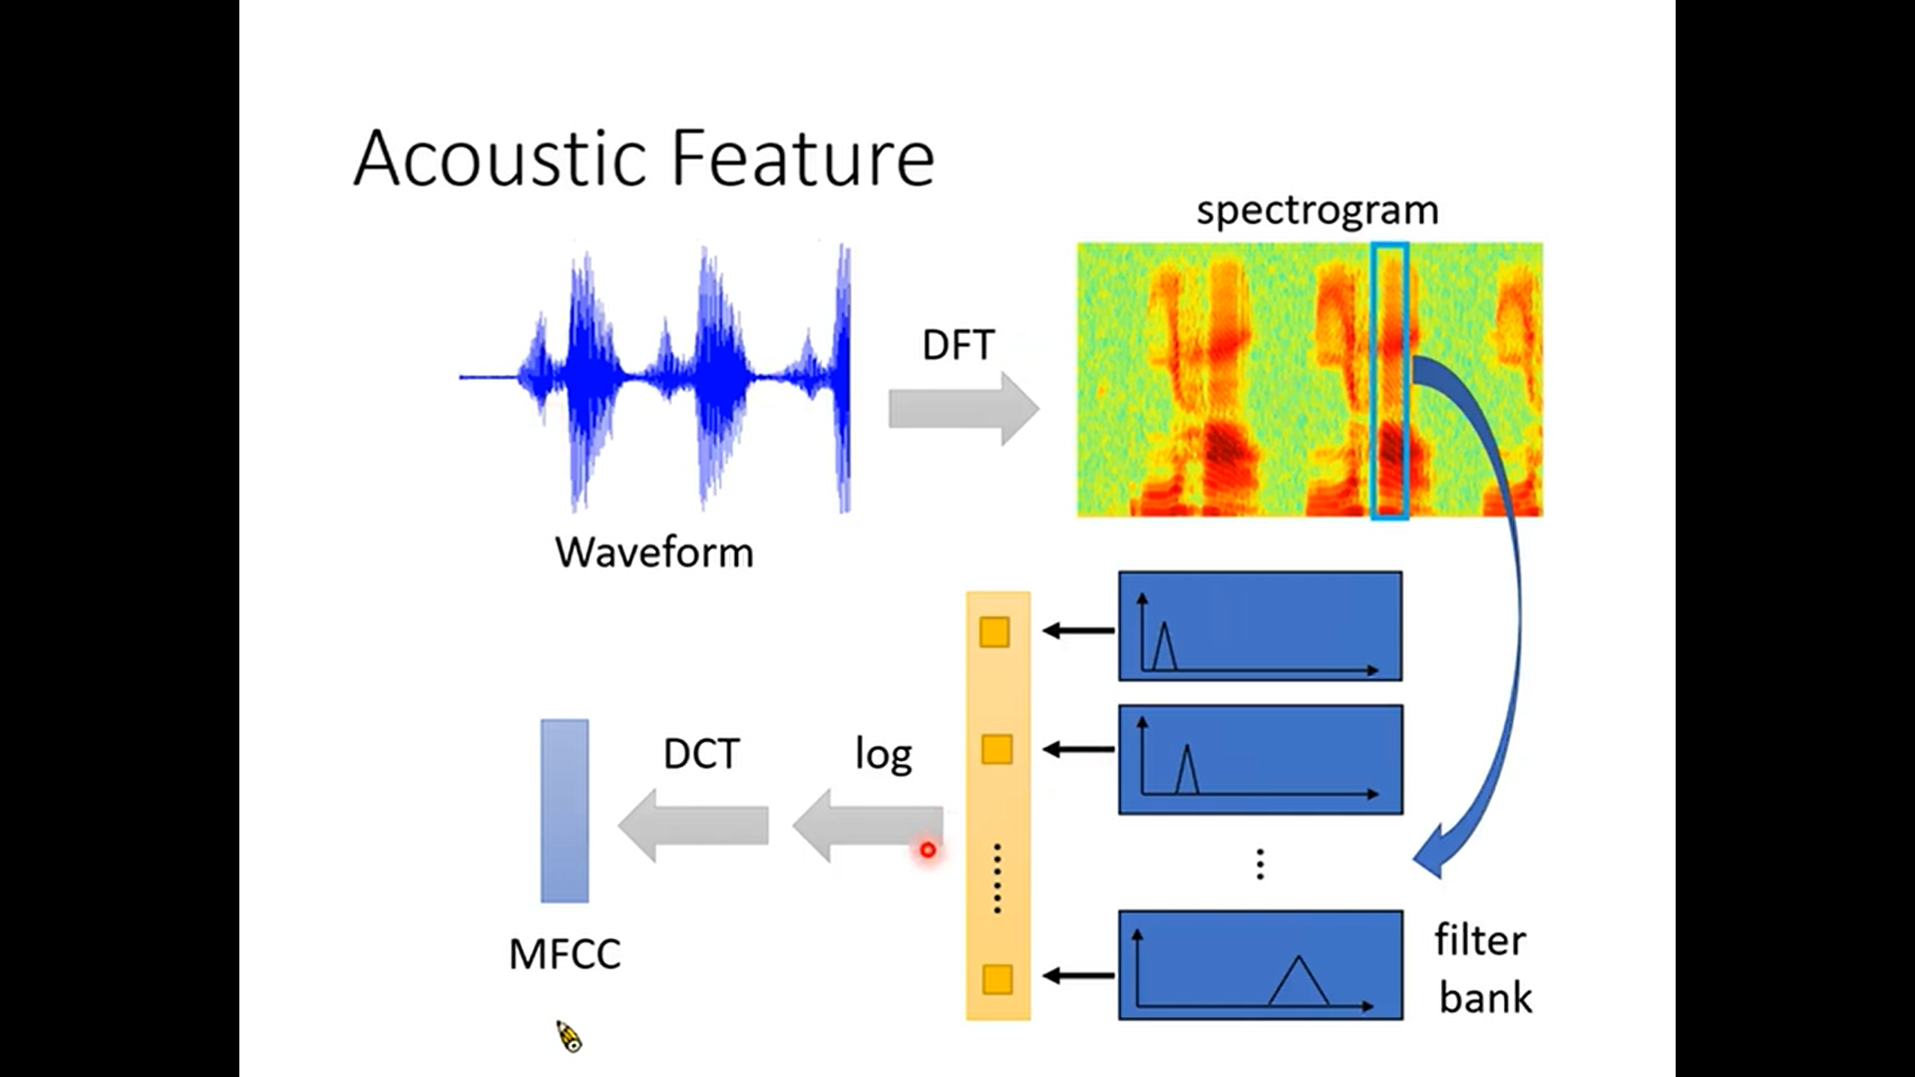

Slide 14
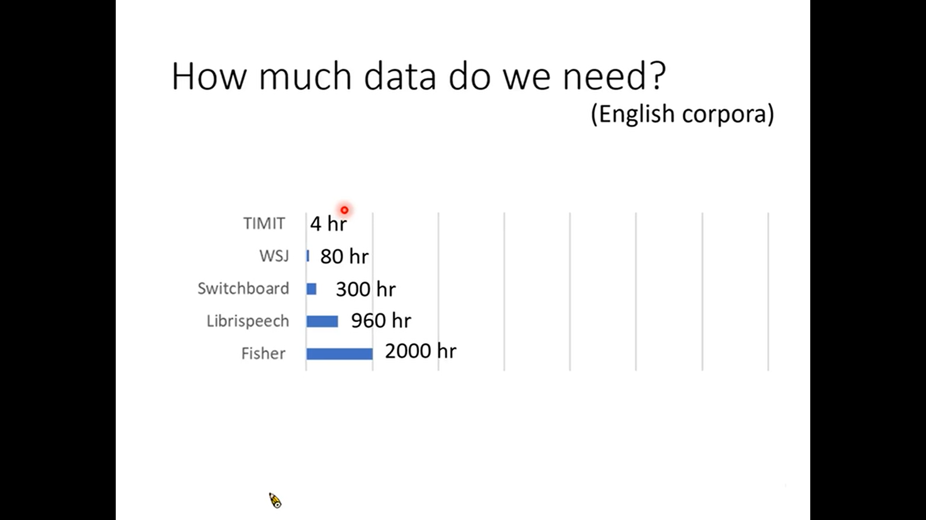

Slide 15
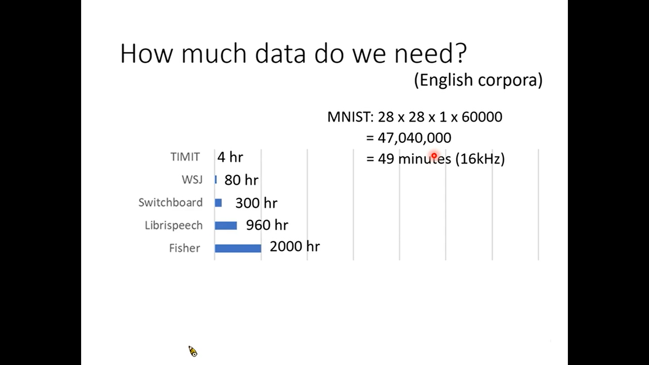

Slide 16
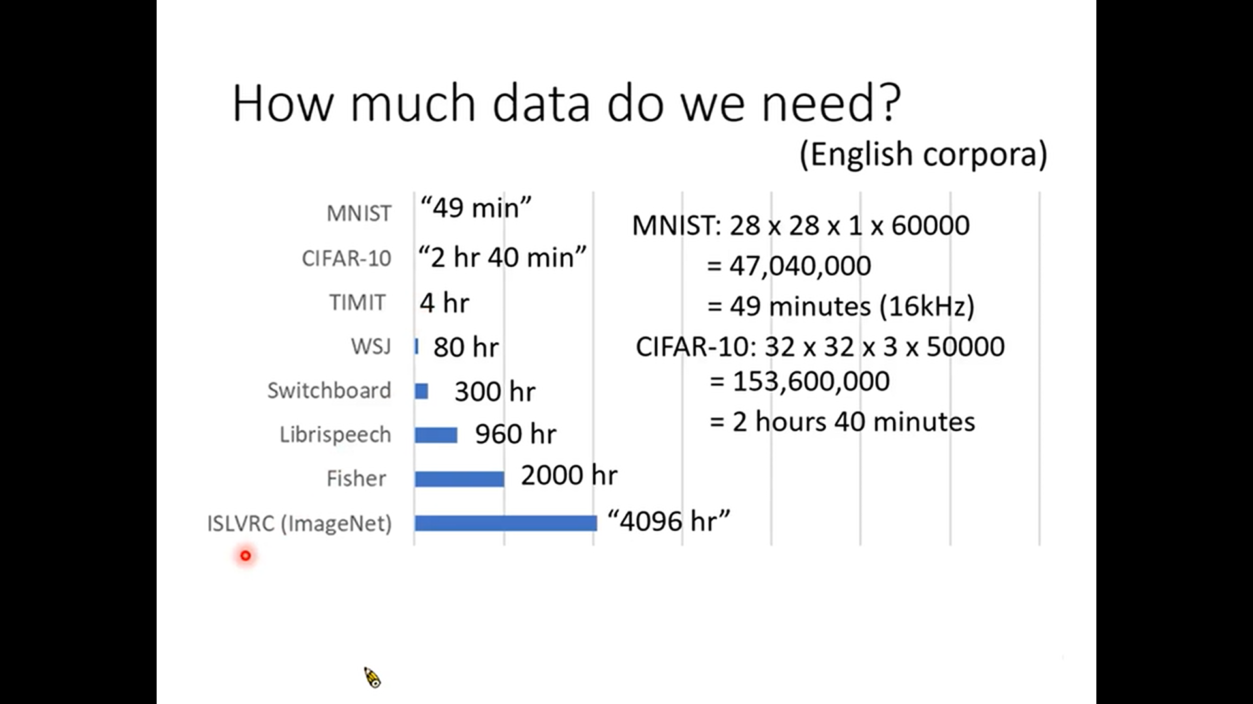

Slide 17
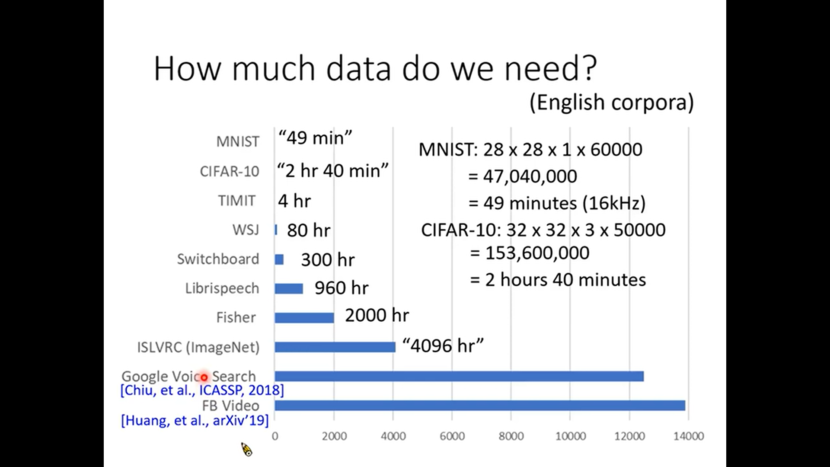

Slide 18
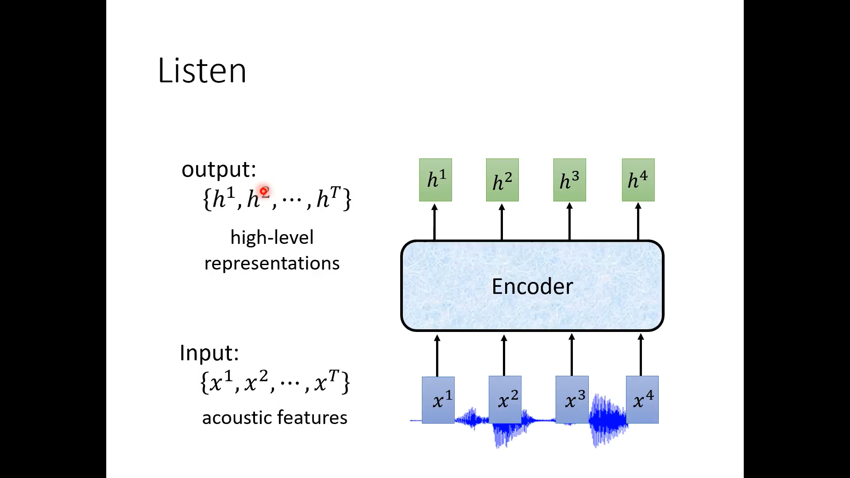

Slide 19
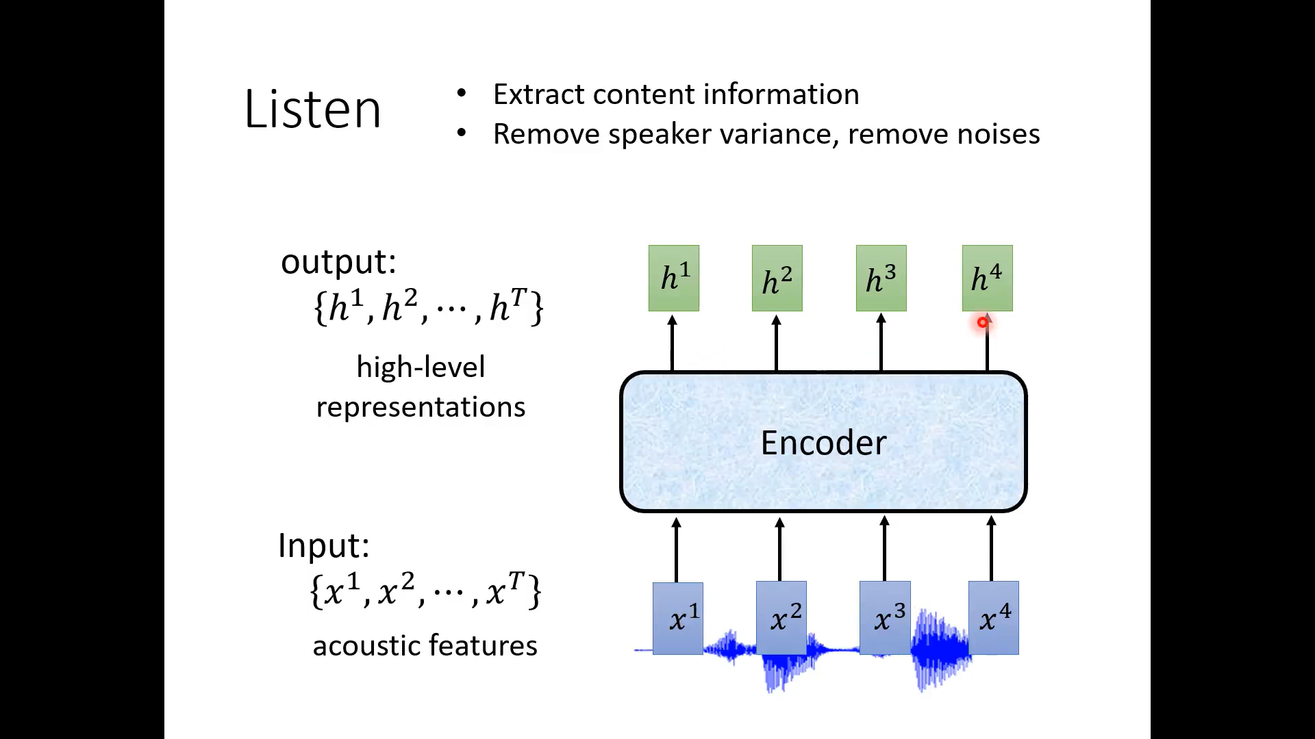

Slide 20
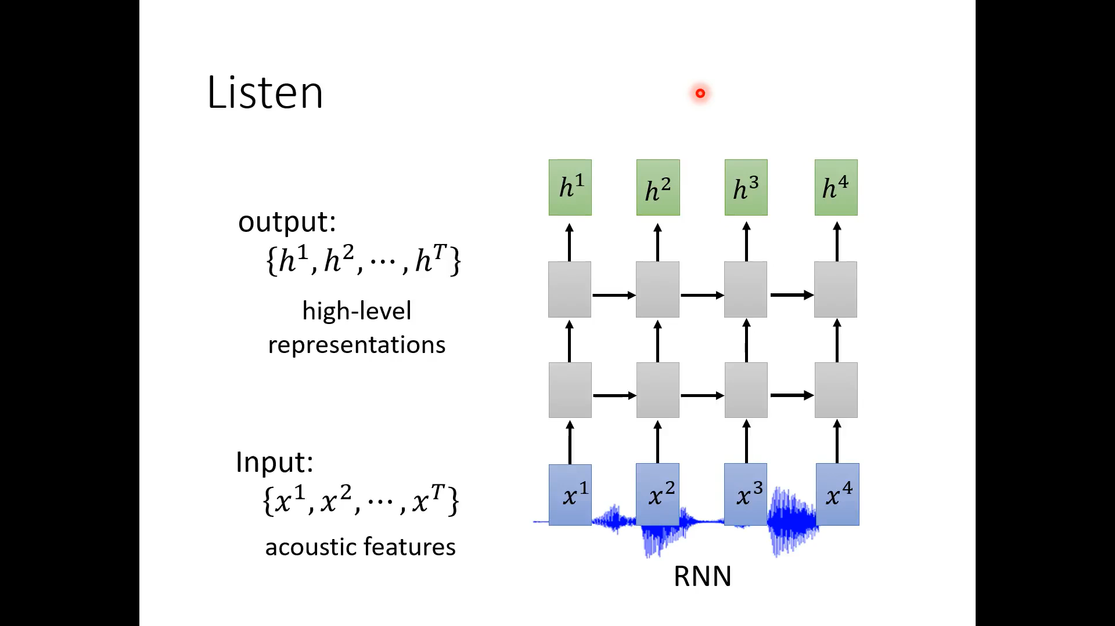

Slide 21
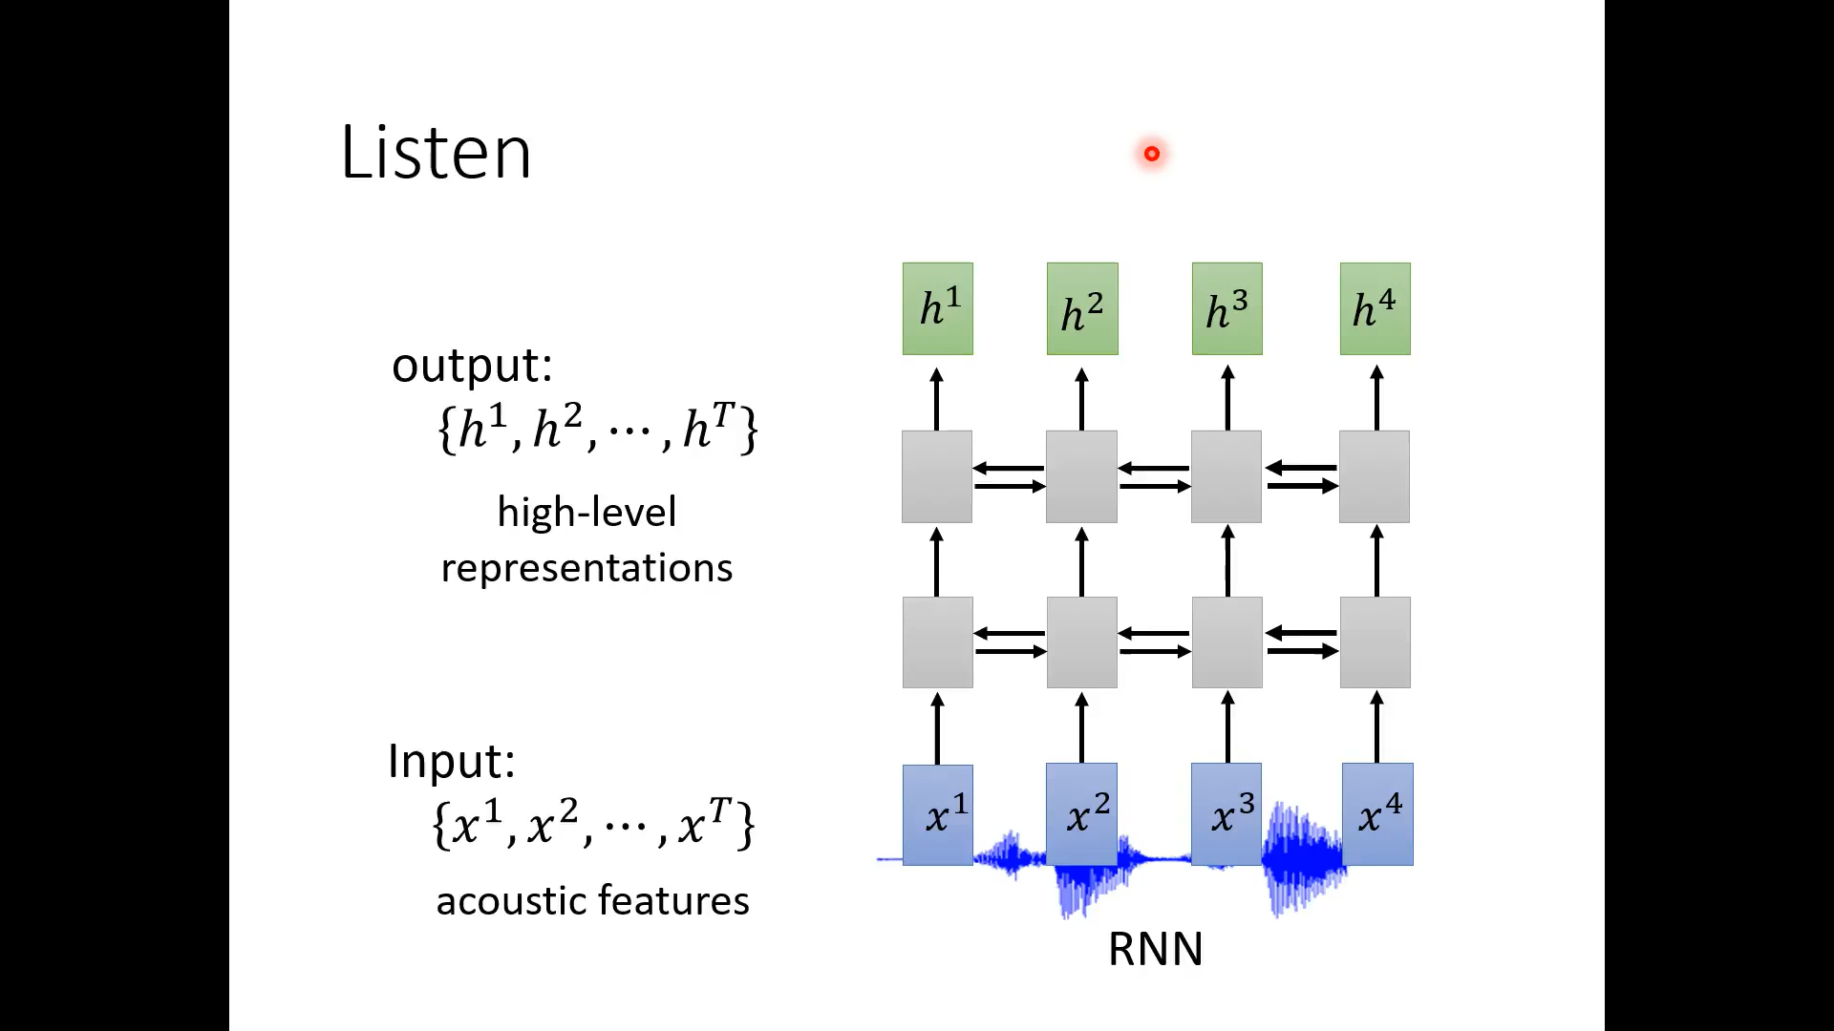

Slide 22
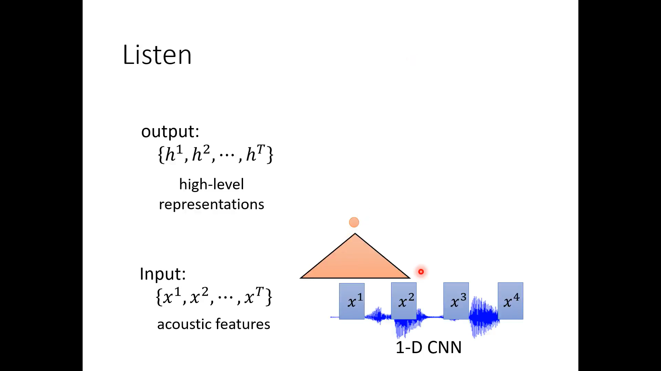

Slide 23
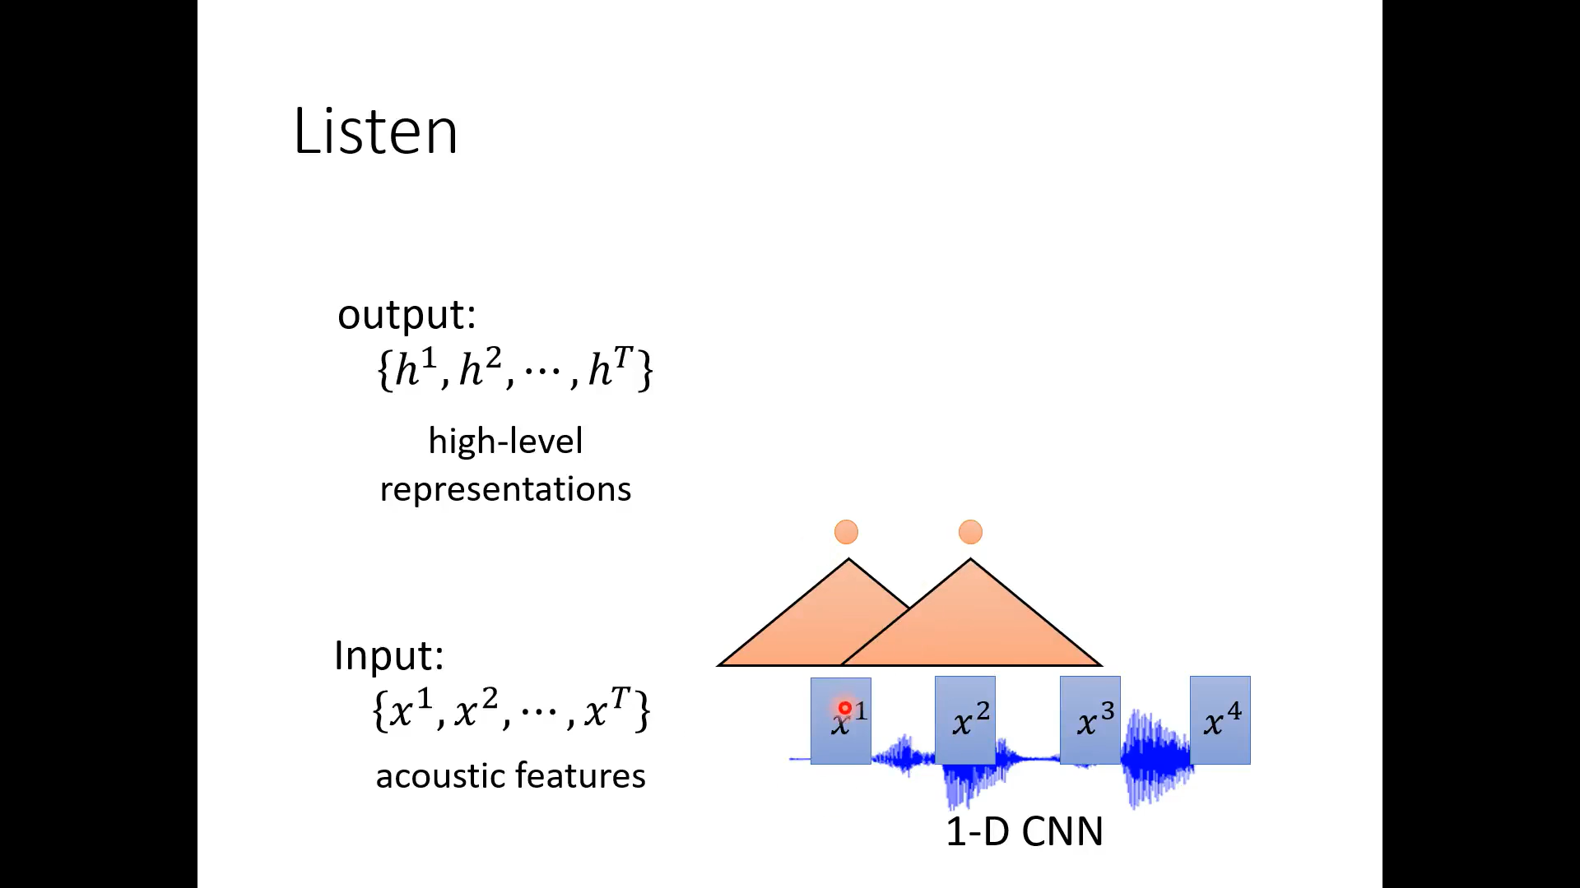

Slide 24
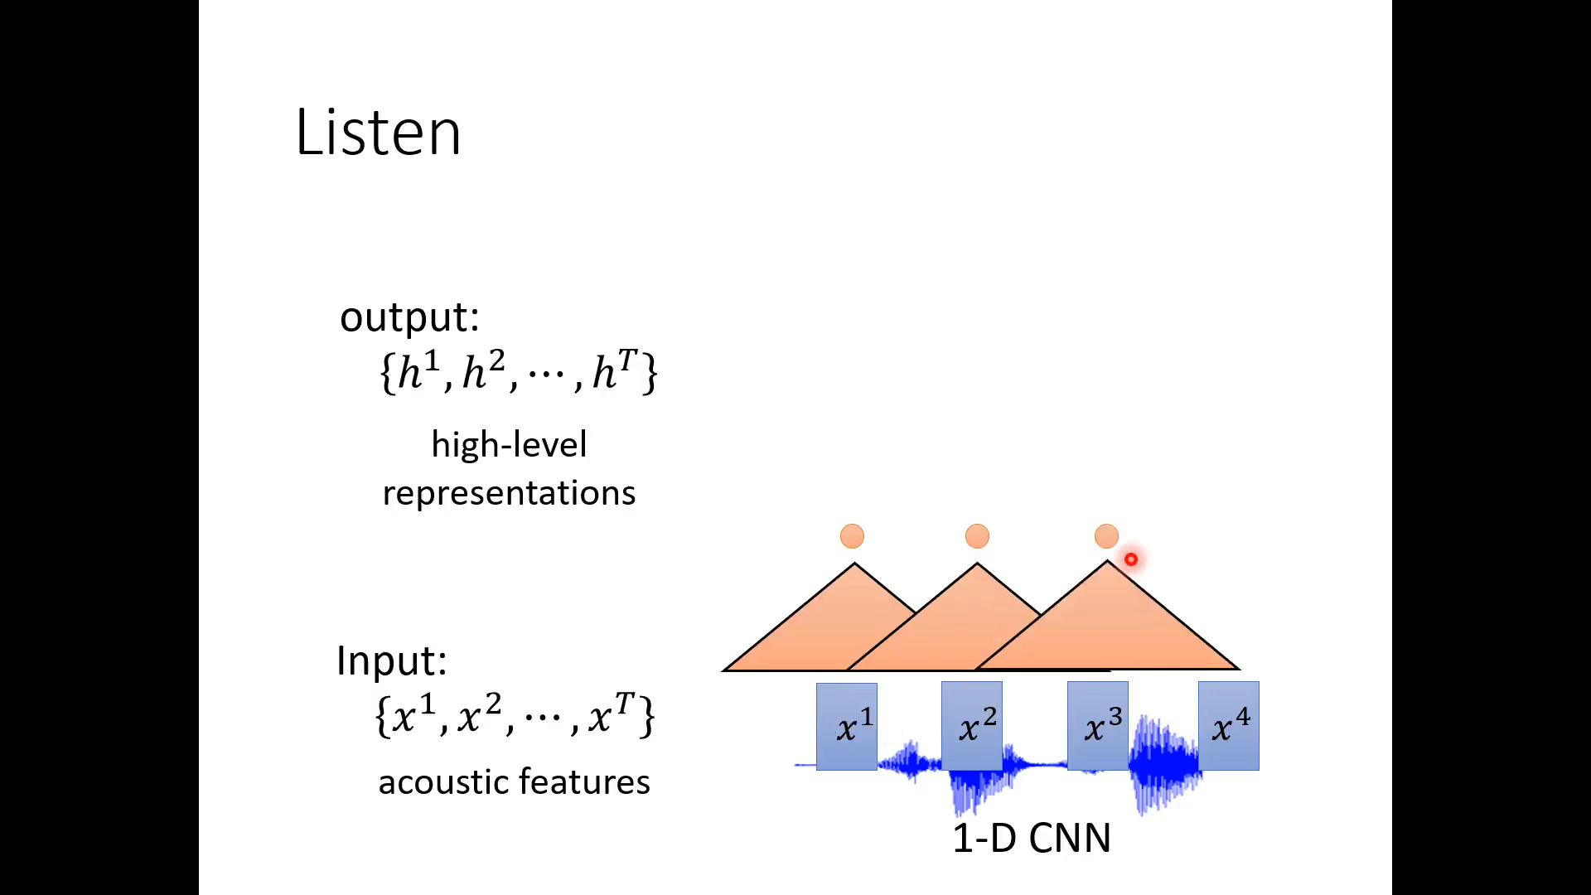

Slide 25
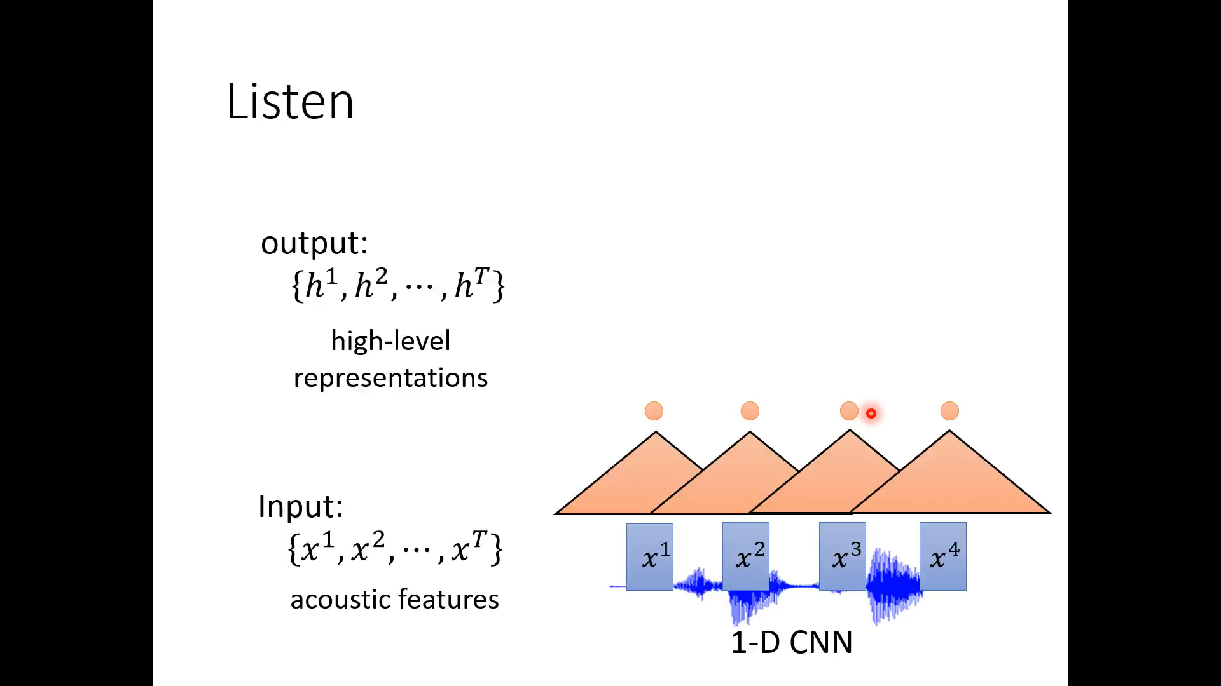

Slide 26
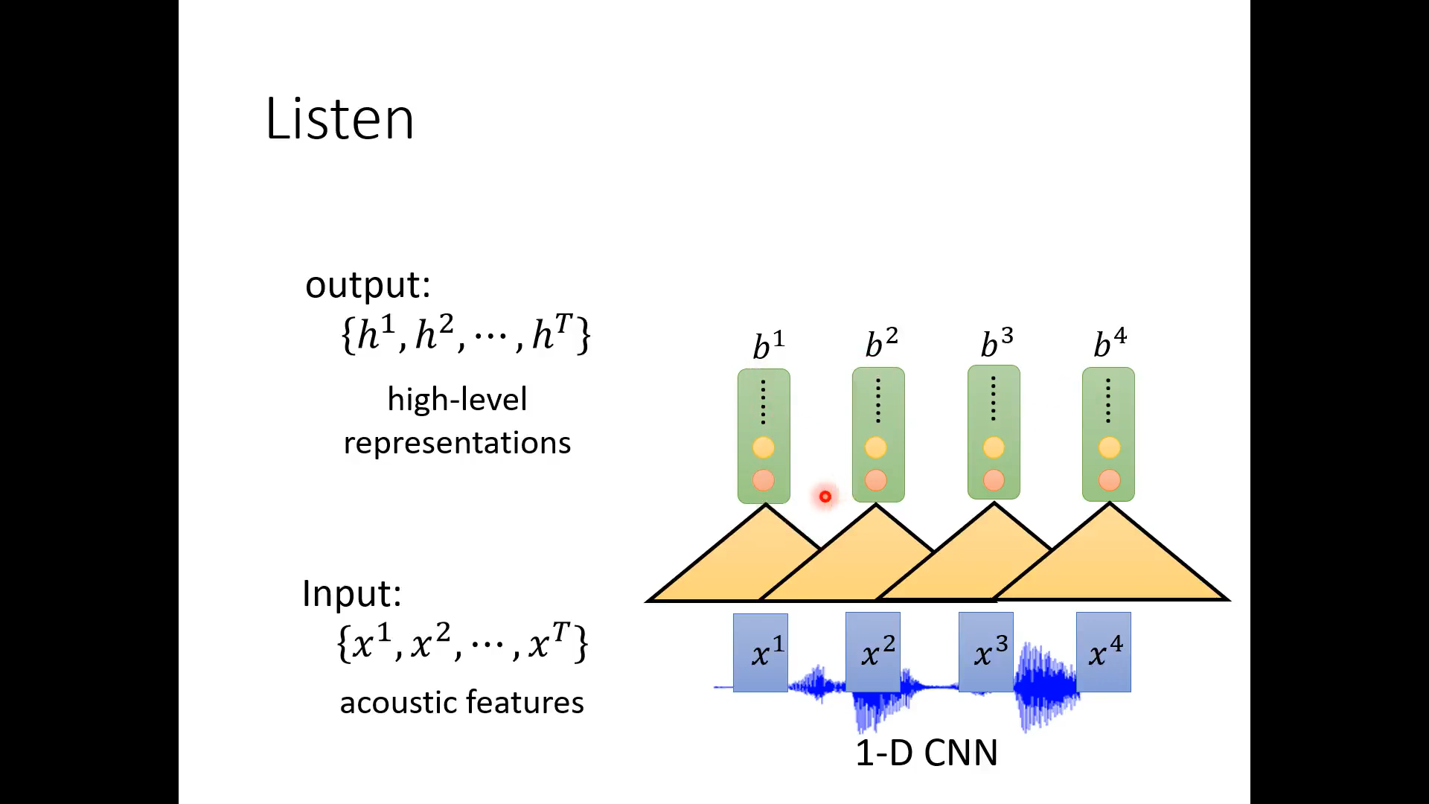

Slide 27
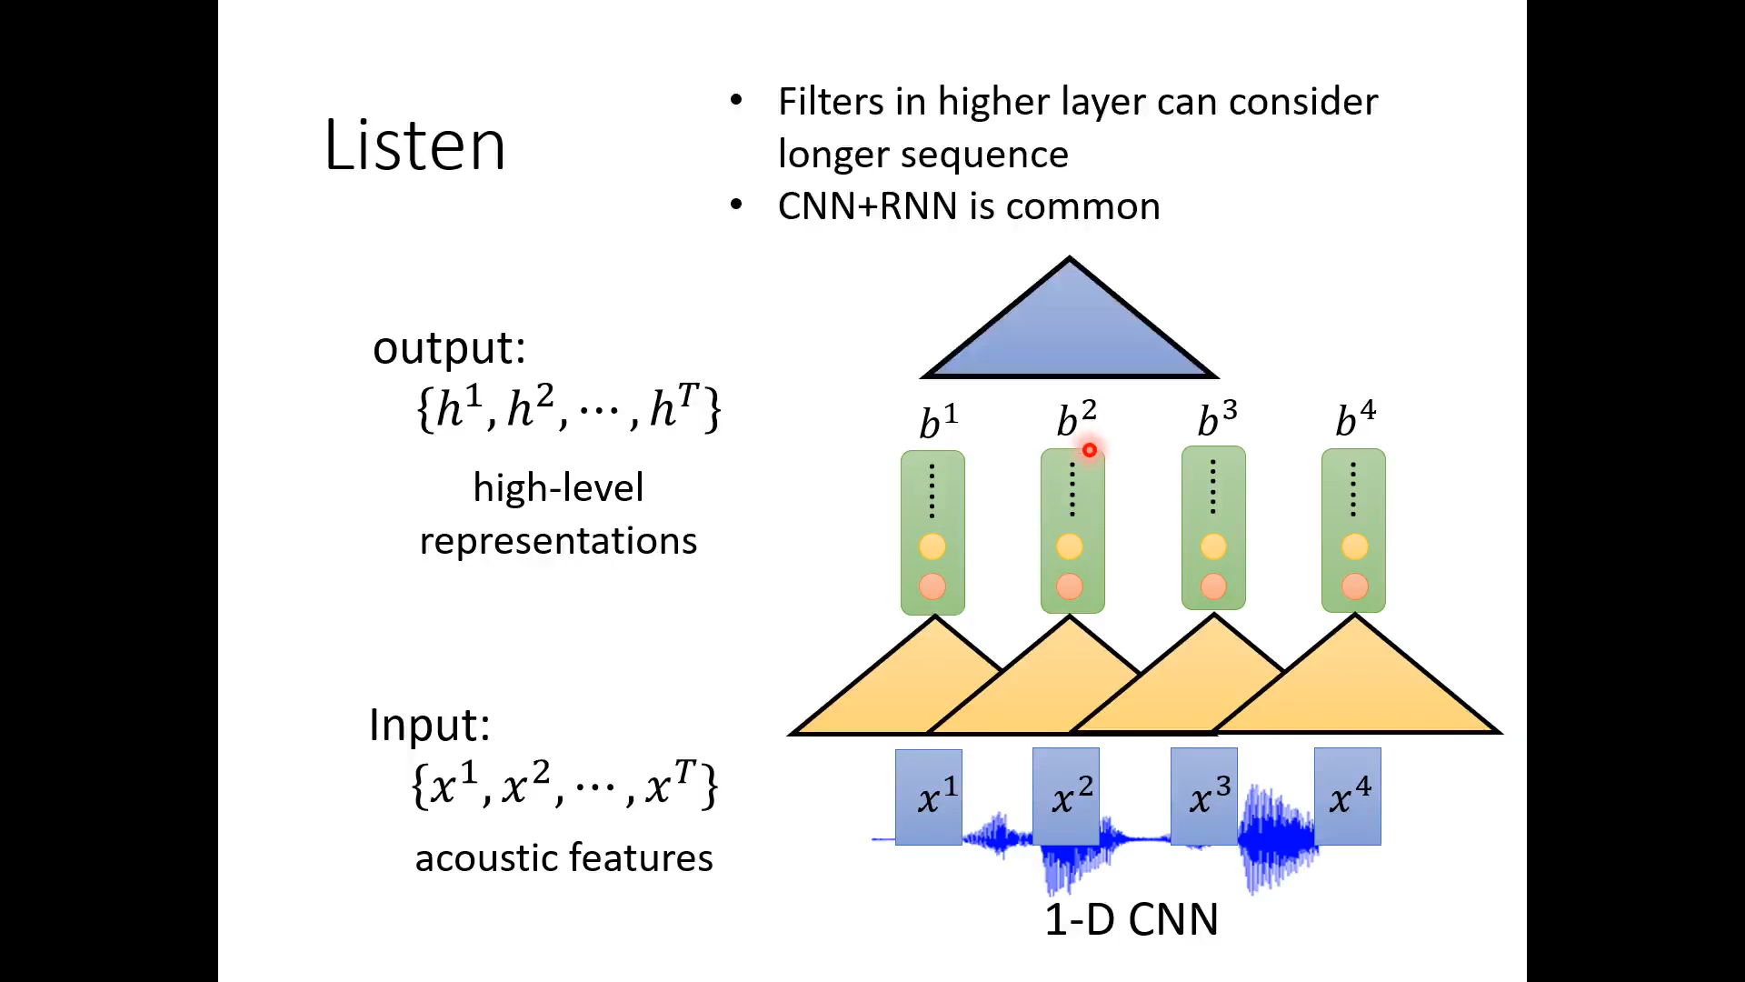

Slide 28
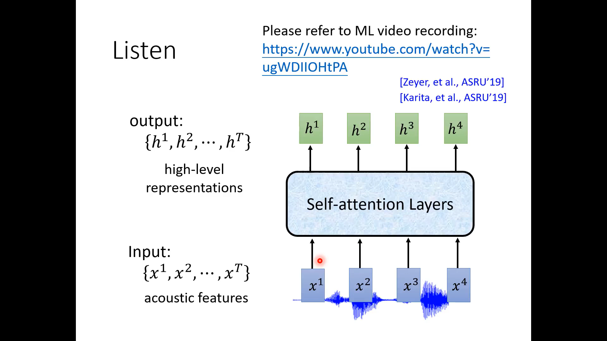

Slide 29
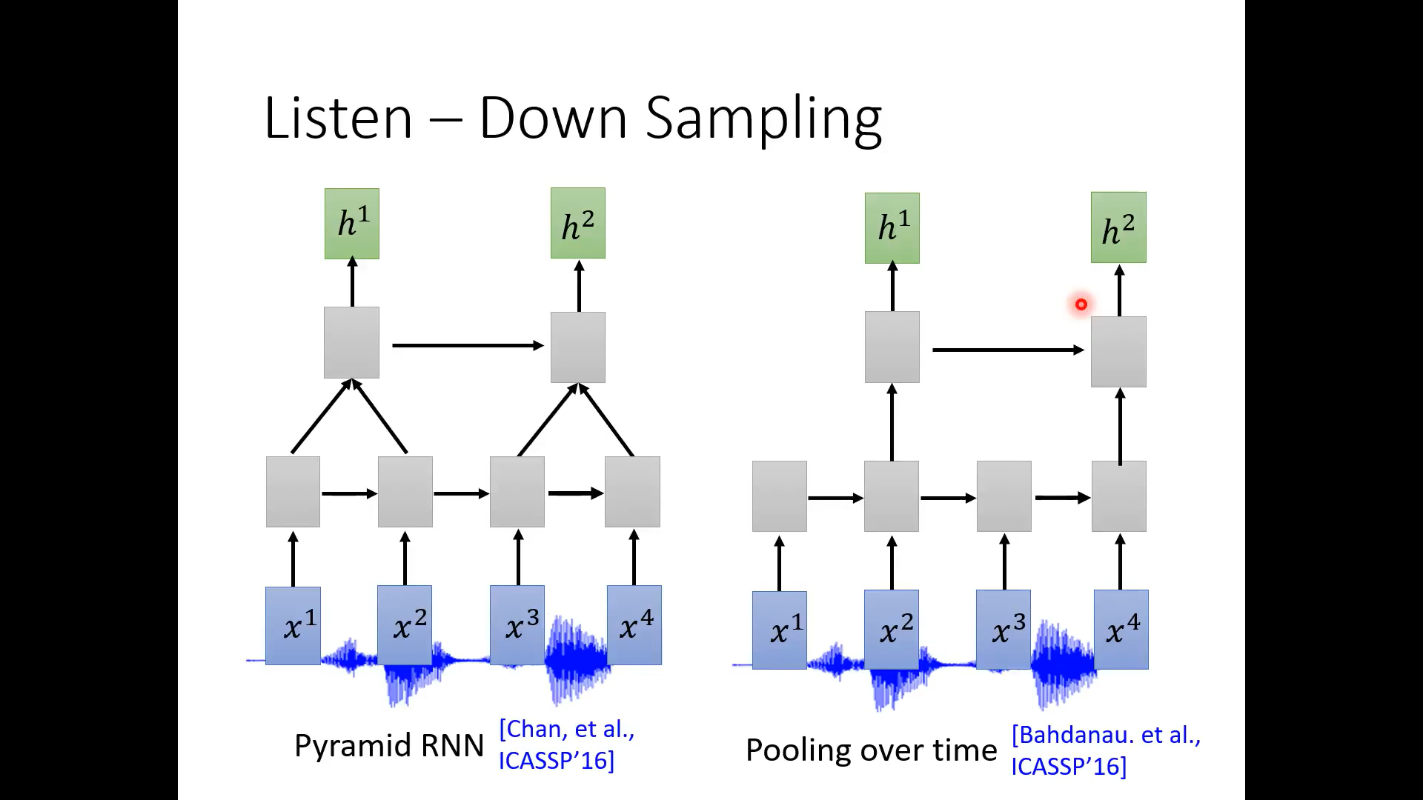

Slide 30
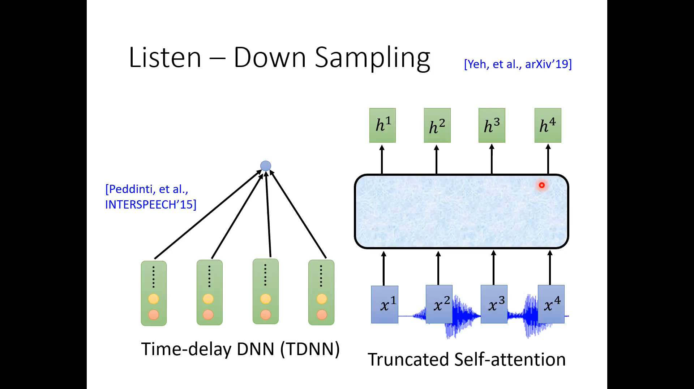

Slide 31
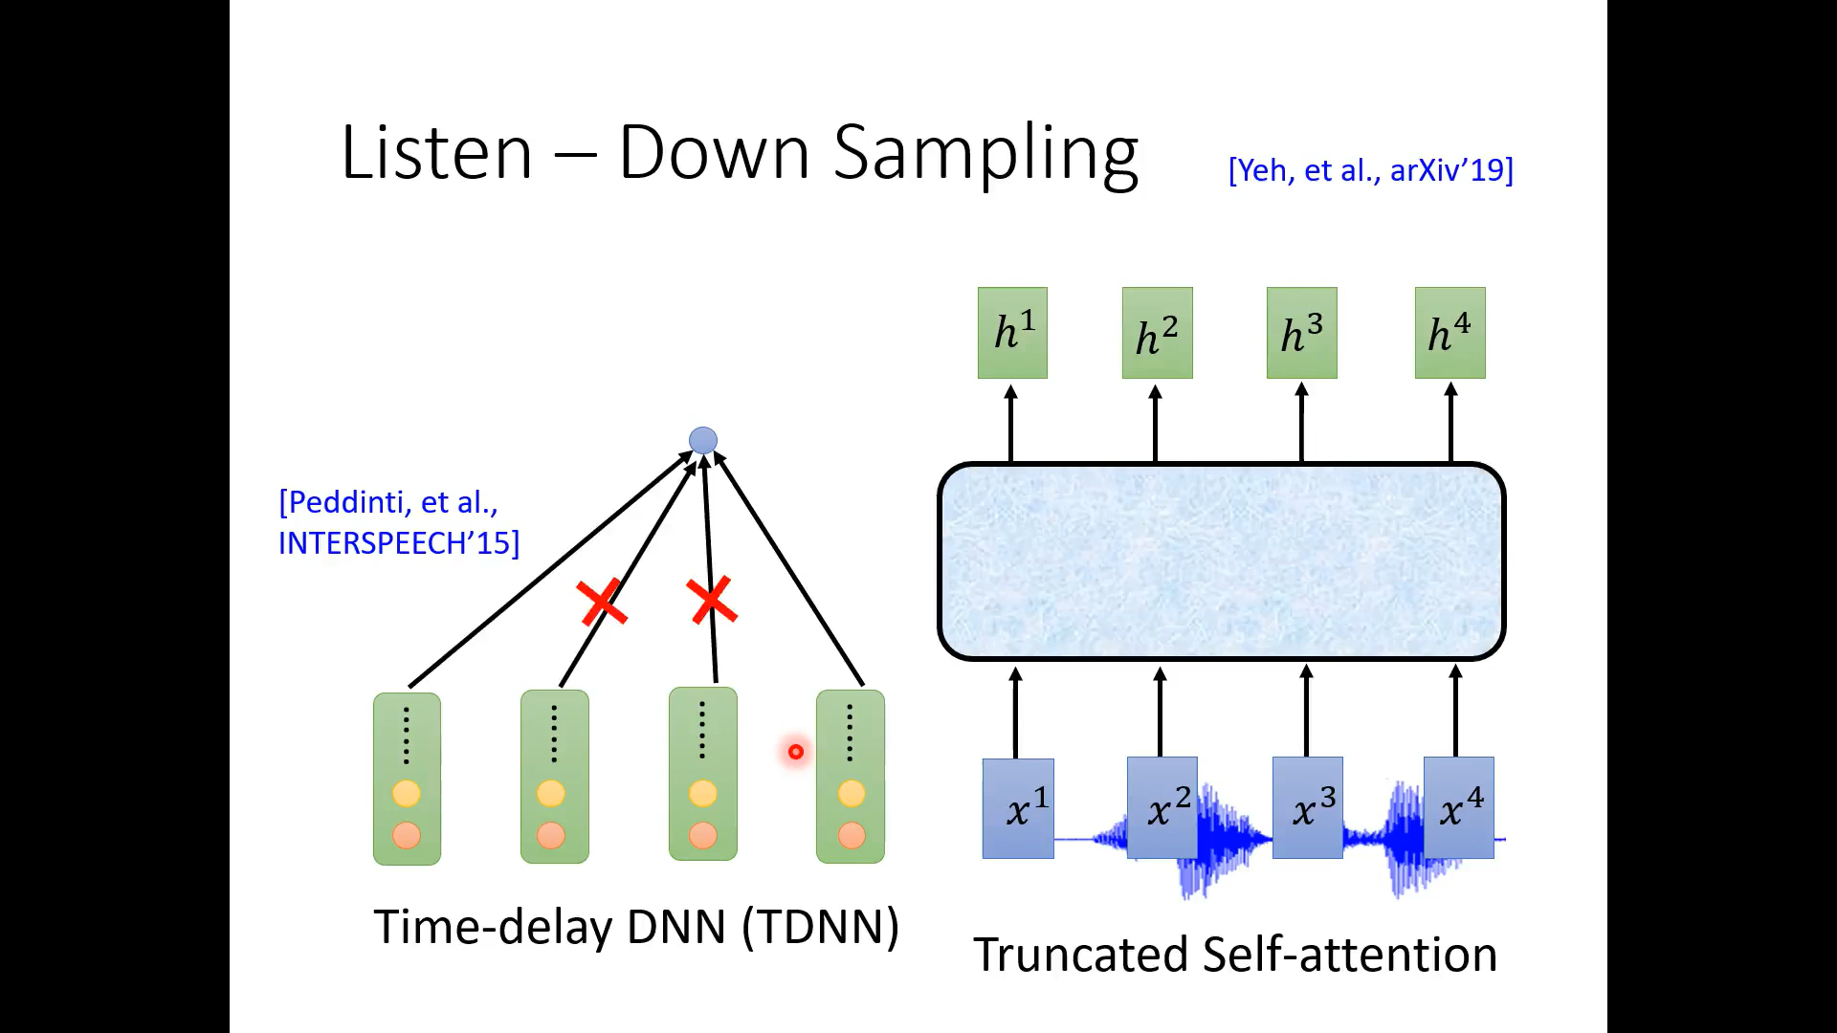

Slide 32
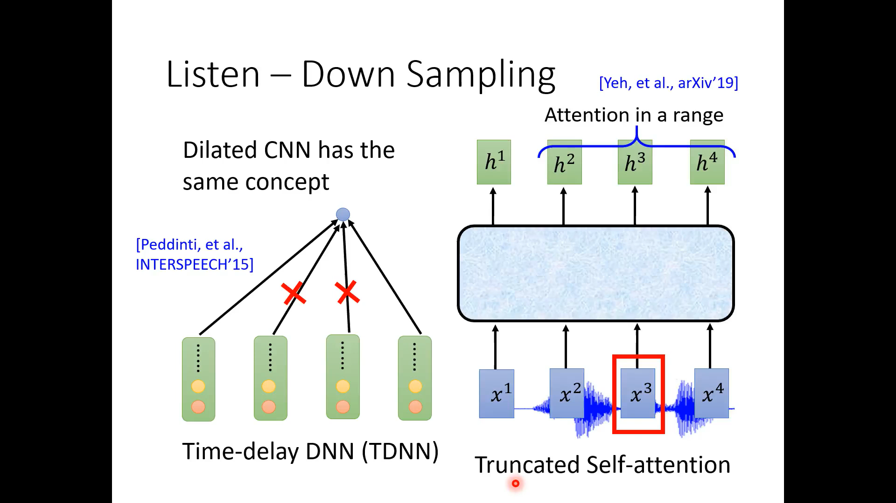

Slide 33
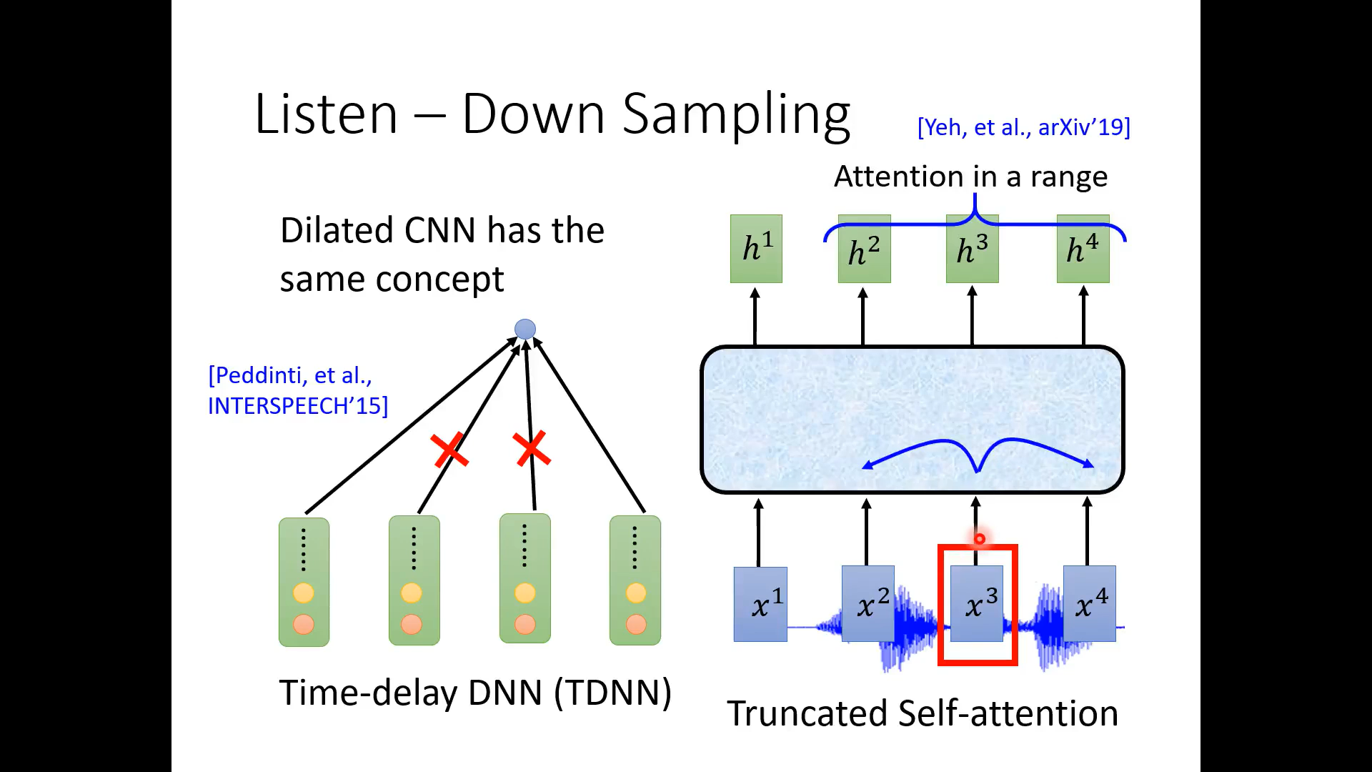

Slide 34
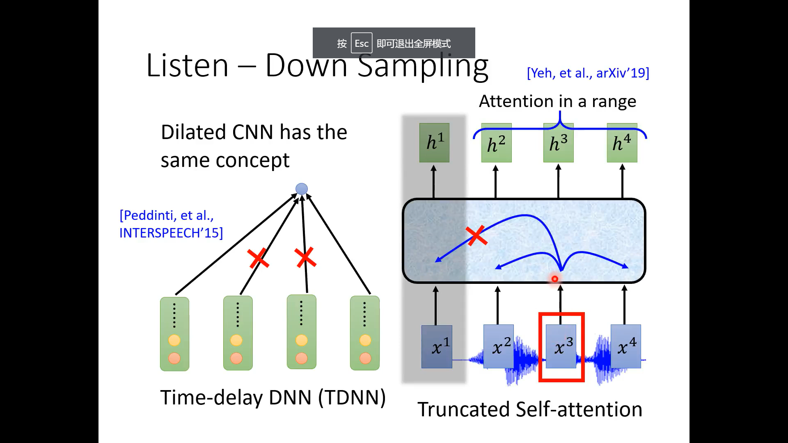

Slide 35
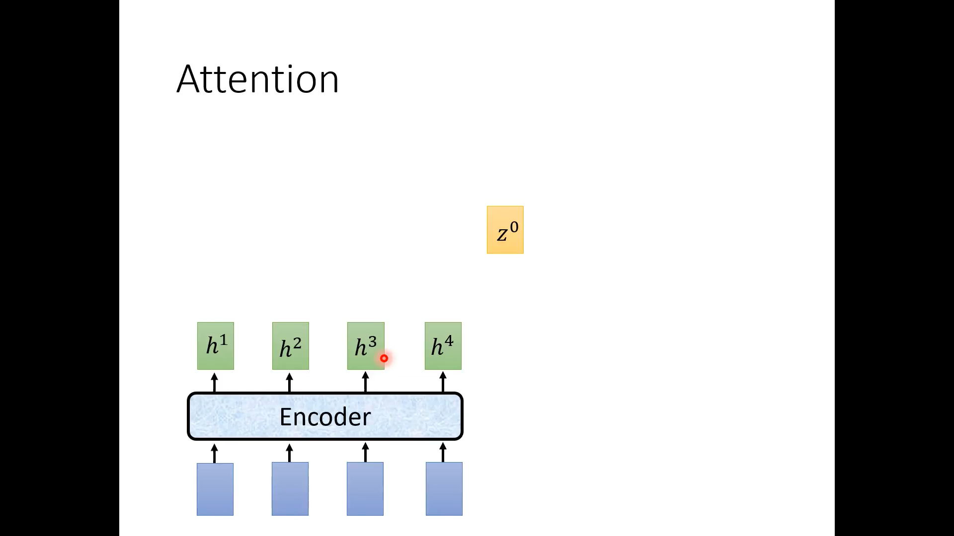

Slide 36
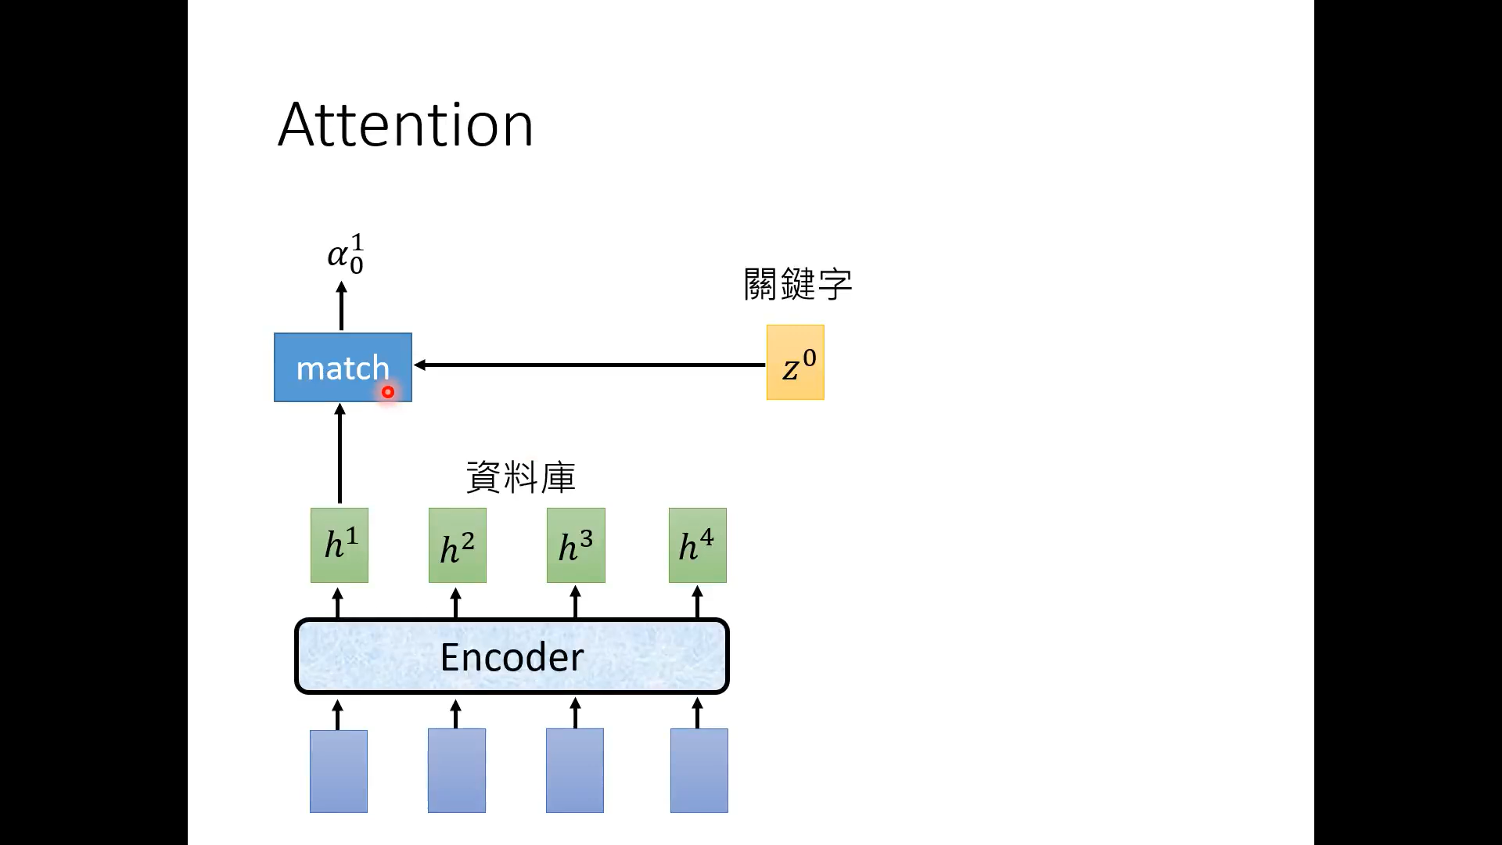

Slide 37
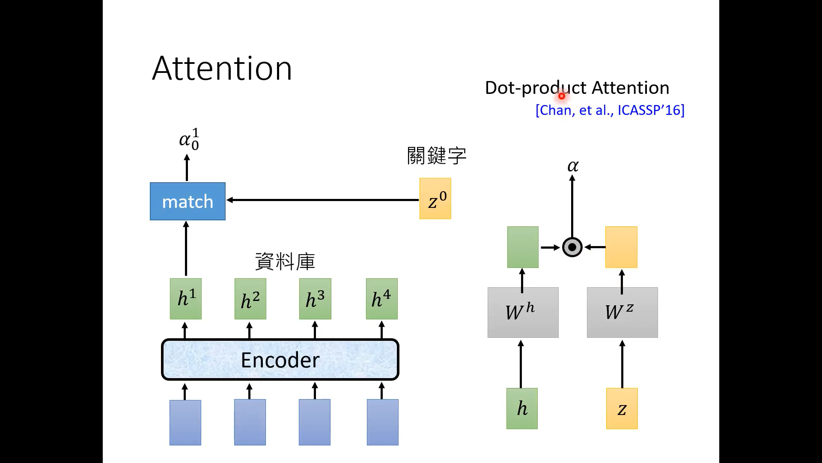

Slide 38
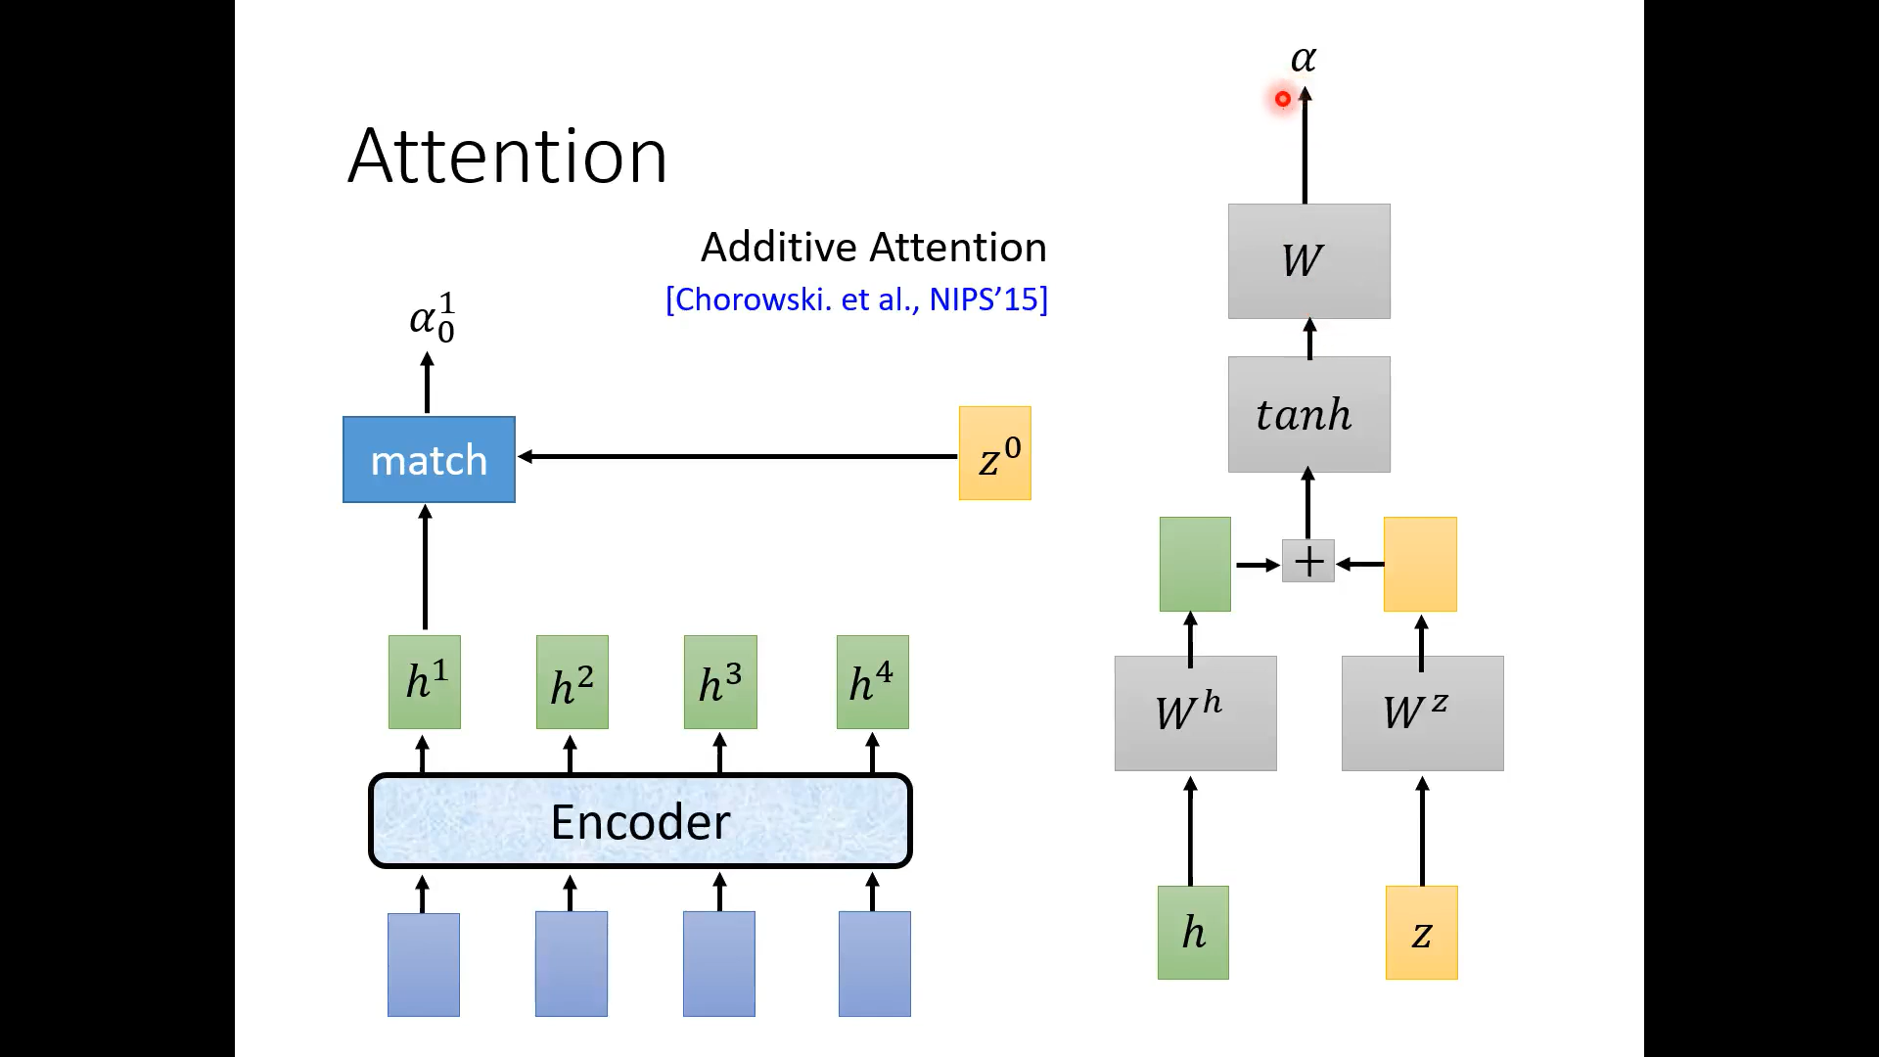

Slide 39
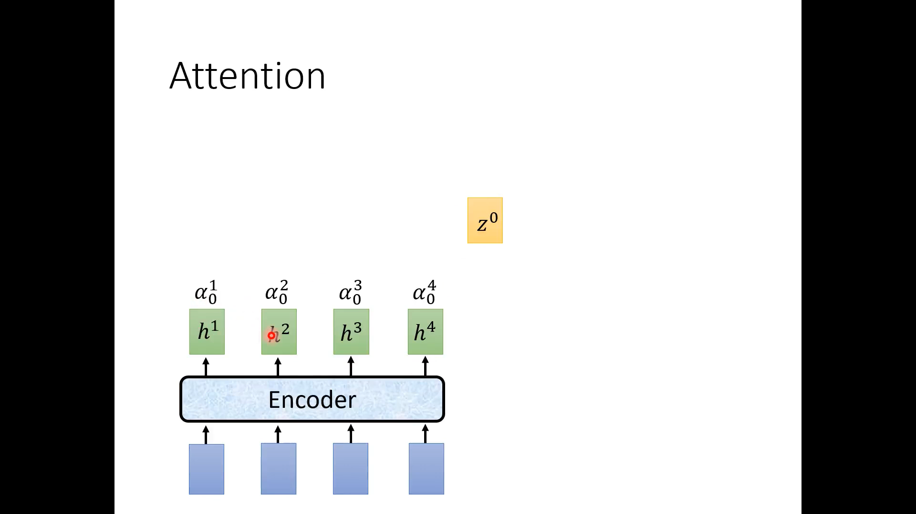

Slide 40
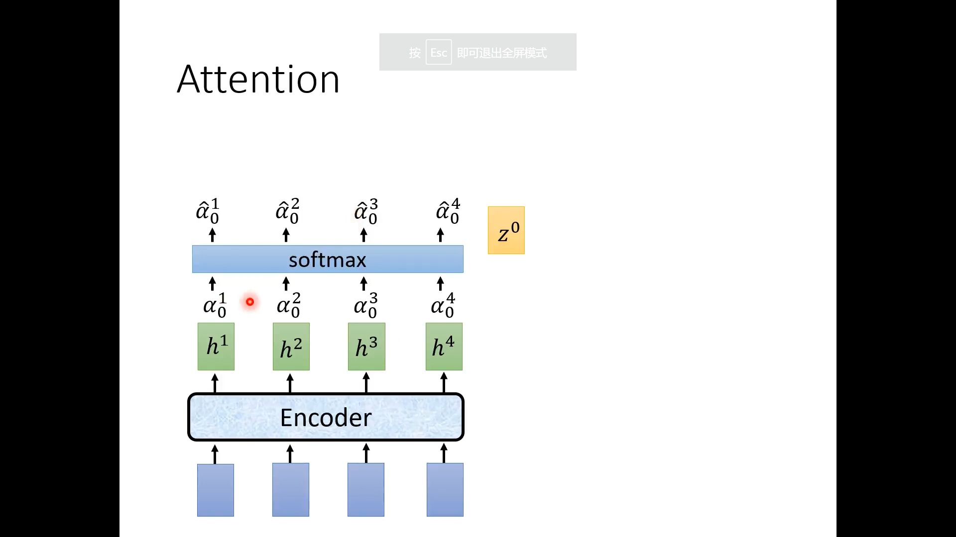

Slide 41
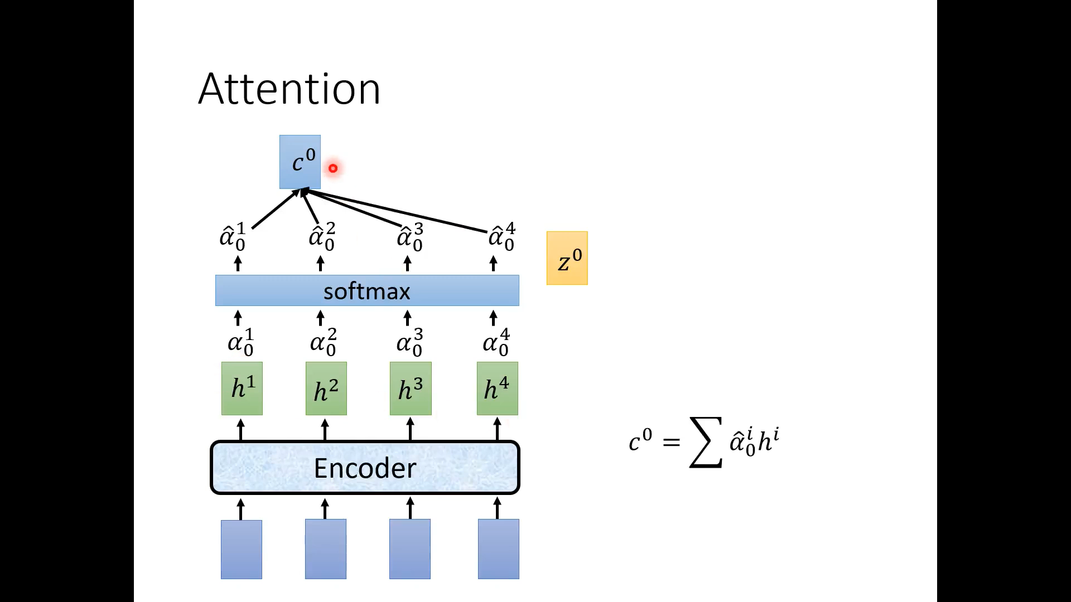

Slide 42
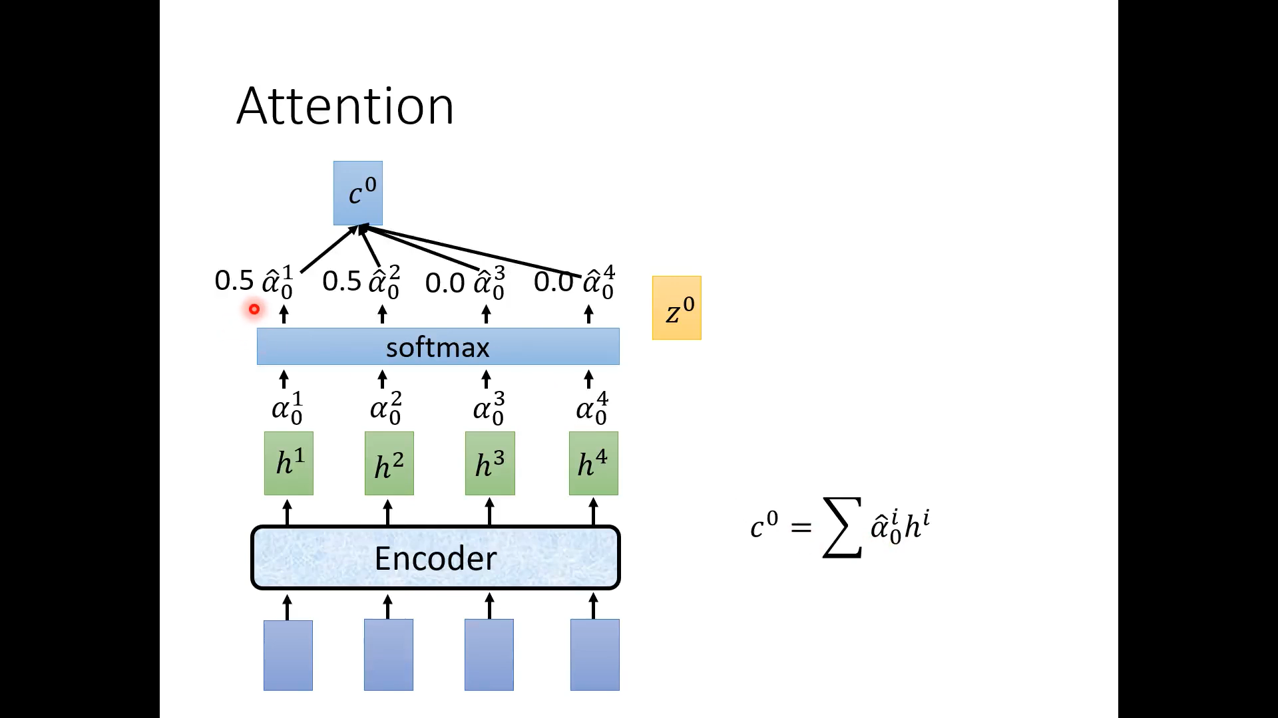

Slide 43
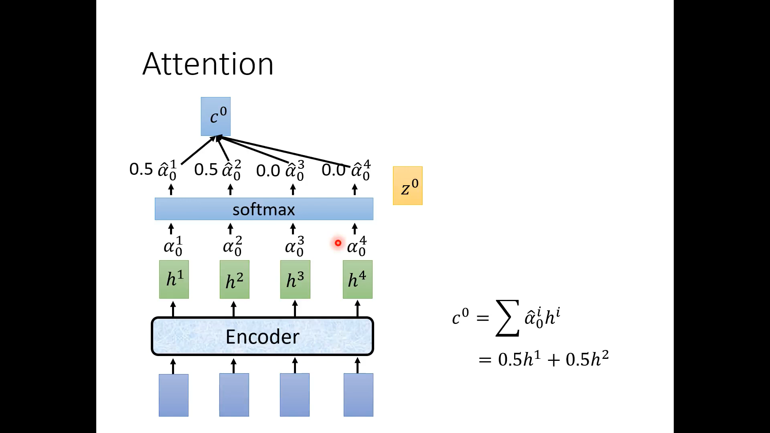

Slide 44
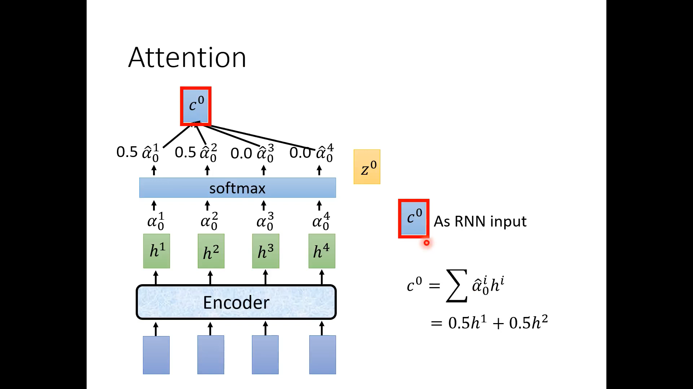

Slide 45
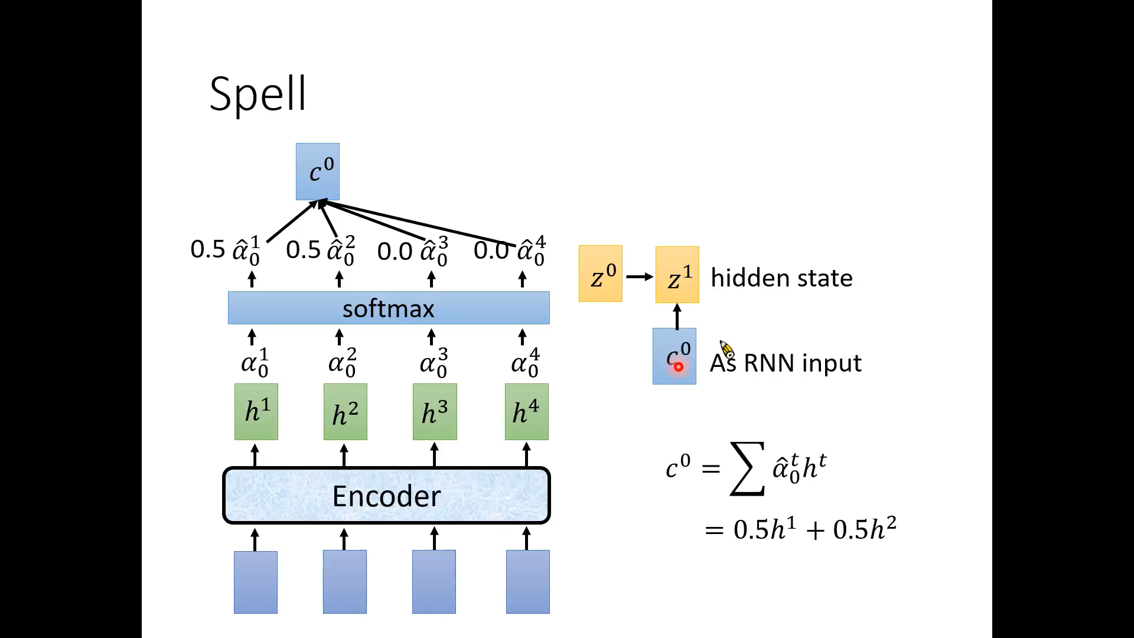

Slide 46
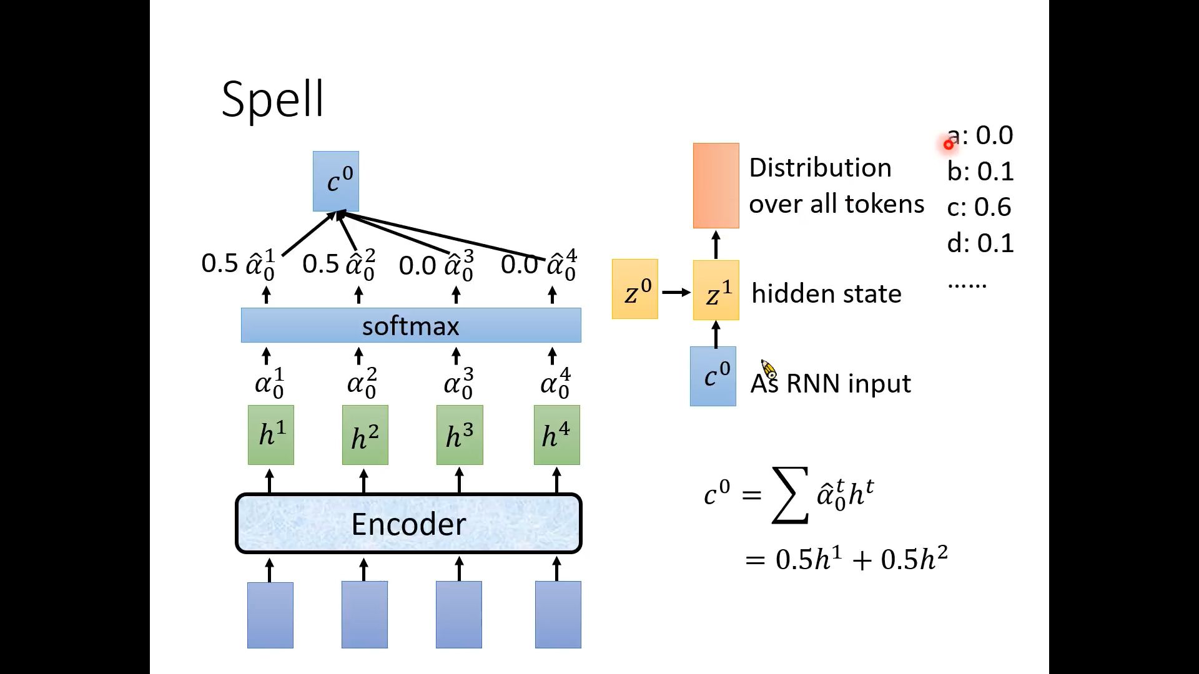

Slide 47
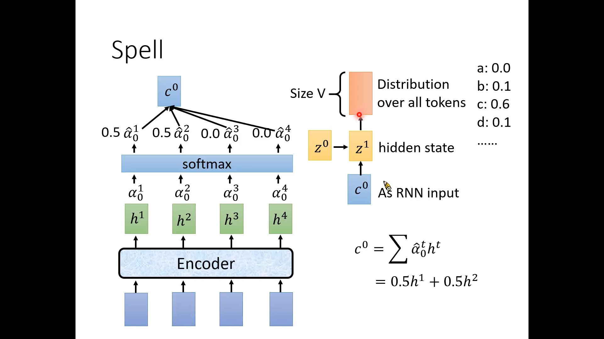

Slide 48
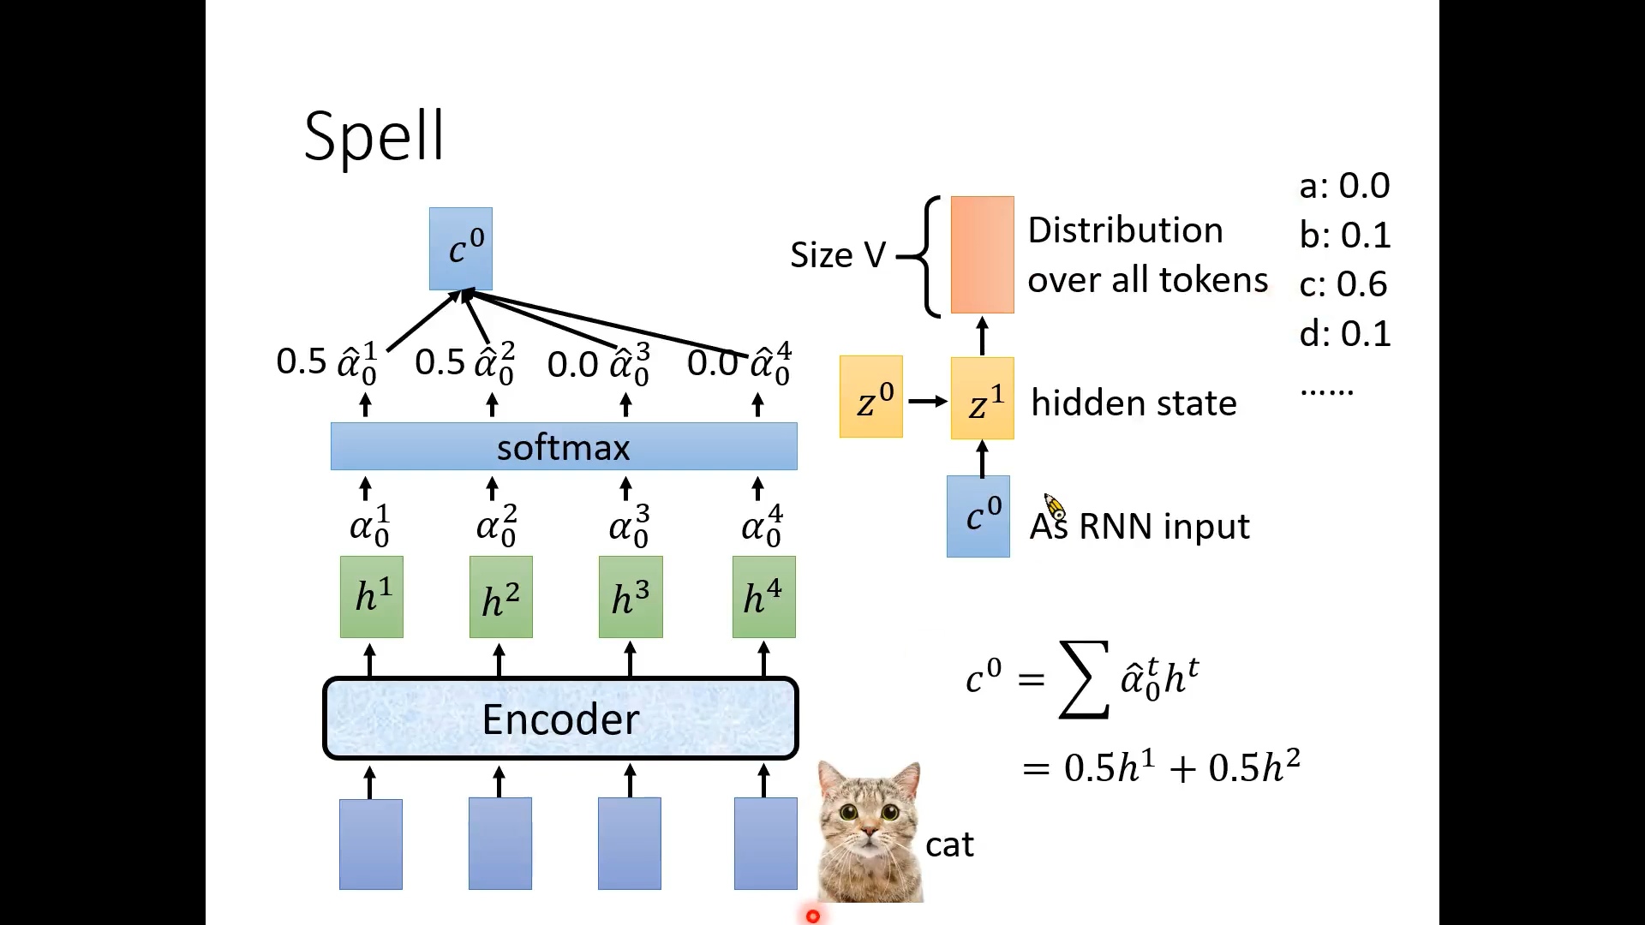

Slide 49


Slide 50
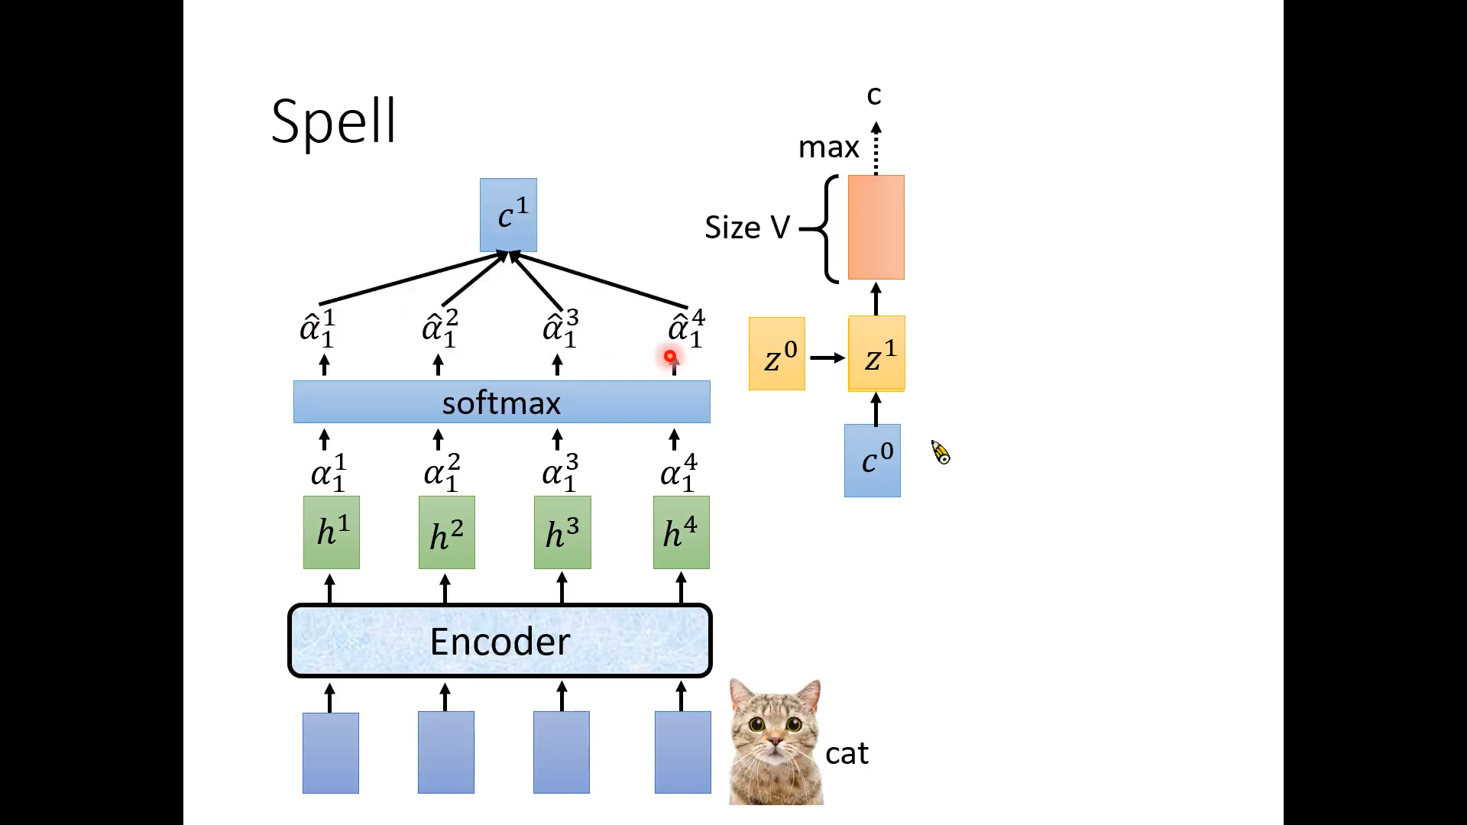

Slide 51
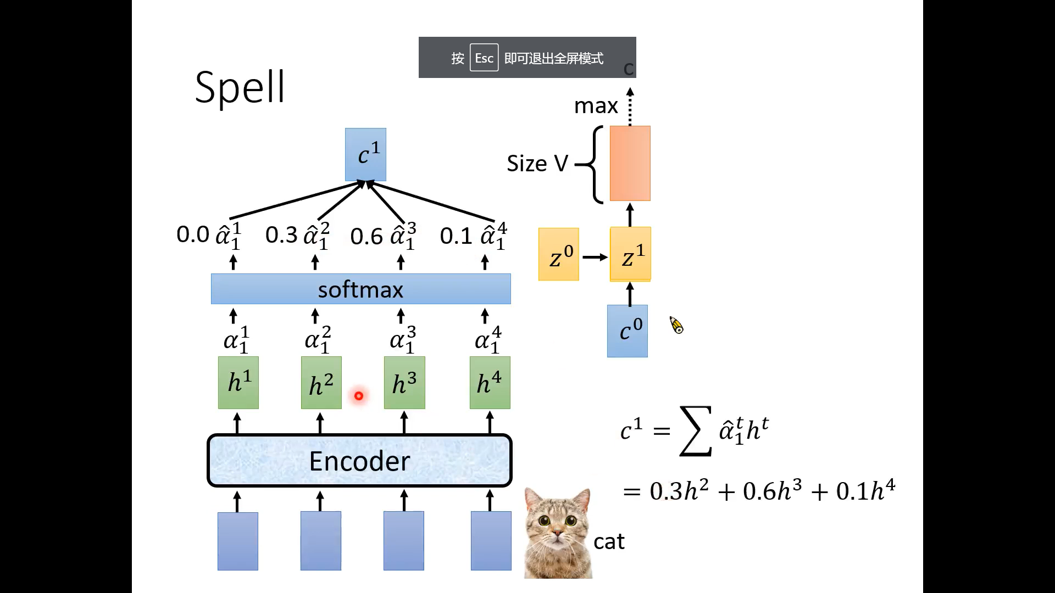

Slide 52
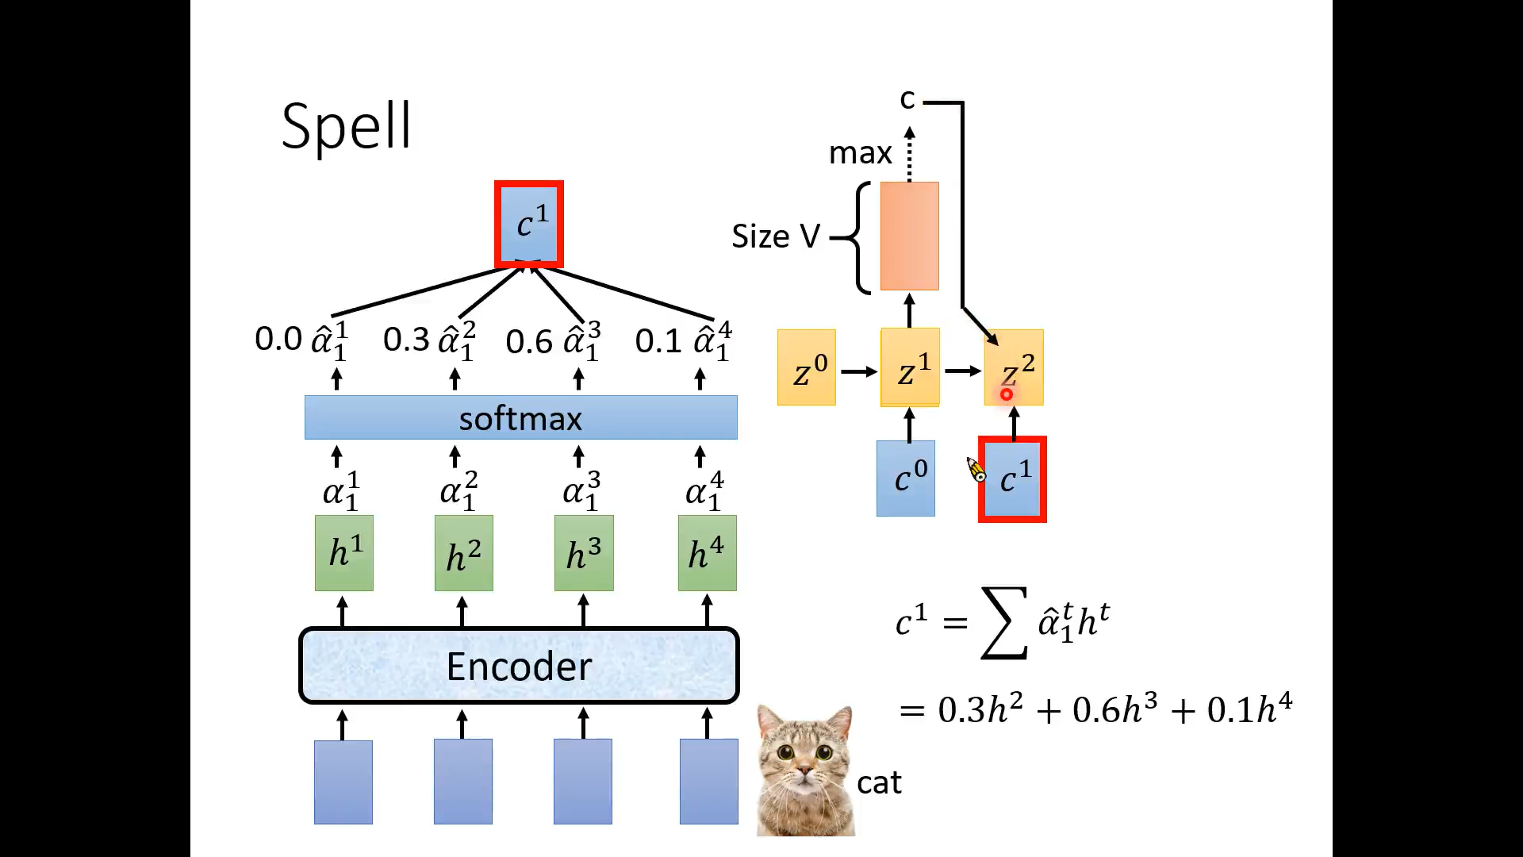

Slide 53
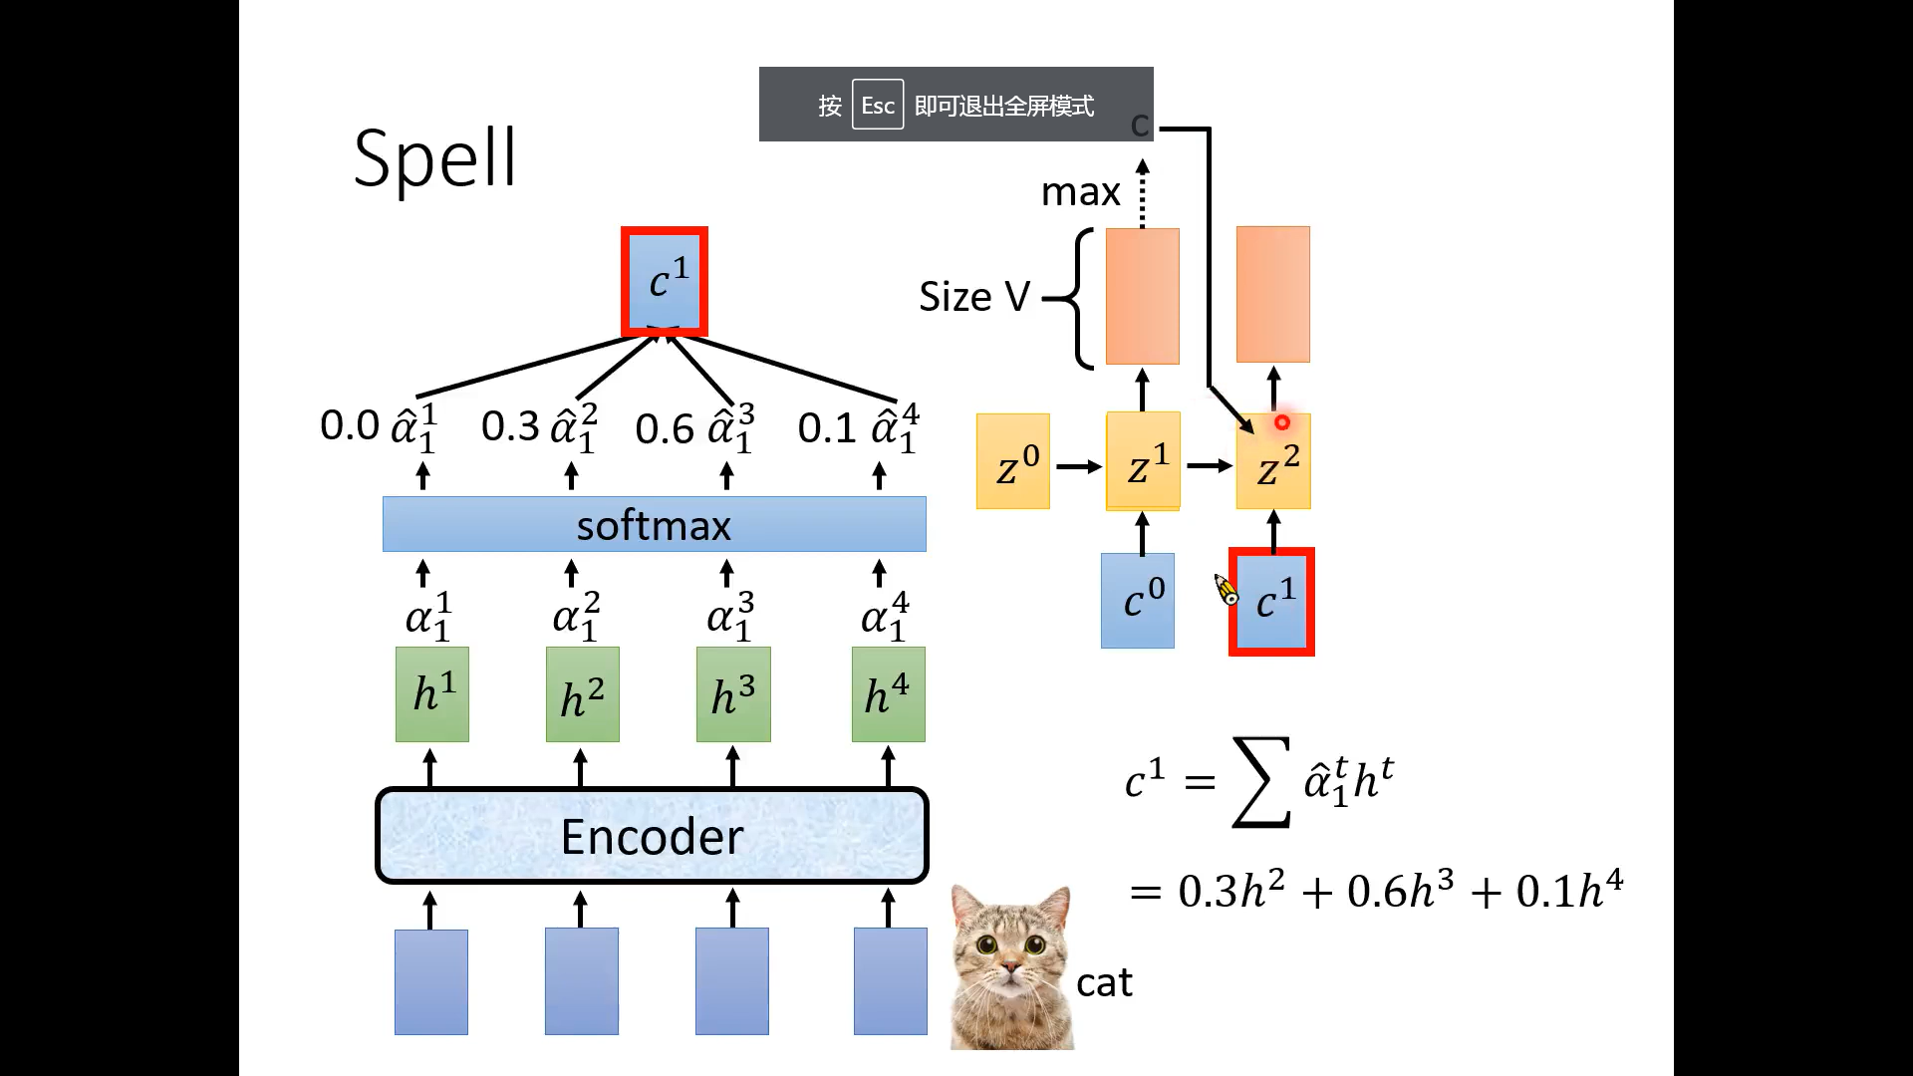

Slide 54


Slide 55


Slide 56


Slide 57


Slide 58


Slide 59


Slide 60


Slide 61


Slide 62


Slide 63


Slide 64


Slide 65


Slide 66


Slide 67


Slide 68


Slide 69
人工智能与听觉
听觉基础
典型的听觉任务与模型
语音识别
语音合成

Slide 70


Slide 71


Slide 72


Slide 73


Slide 74


Slide 75


Slide 76


Slide 77


Slide 78


Slide 79


Slide 80


Slide 81


Slide 82


Slide 83


Slide 84


Slide 85


Slide 87


Slide 88


Slide 89


Slide 90


Slide 91


Slide 92


Slide 93


Slide 94


Slide 95

Problem
End-to-end neural TTS has shown advantages over concatenative synthesis and statistical parametric synthesis
Production online model: Emphasis[1]/Tacotron[2]
SOTA model in research: Tacotron[2]/Transformer[3]
However, end-to-end neural TTS still suffers from the following problems
Slow inference speed: autoregressive mel-spectrogram generation is slow for long sequence;
Not robust: words skipping and repeating;
You can call me directly at 4257037344 or my cell 4254447474 or send me a meeting request with all the appropriate information.
[1] Li et al, EMPHASIS: An Emotional Phoneme-based Acoustic Model for Speech Synthesis System. InterSpeech 2018.
[2] Shen et al. Natural tts synthesis by conditioning wavenet on mel spectrogram predictions. ICASSP 2018.
[3] Li et al, Neural Speech Synthesis with Transformer Network. AAAI 2019.

Slide 96
Problem
End-to-end neural TTS has shown advantages over concatenative synthesis and statistical parametric synthesis
Production online model: Emphasis[1]/Tacotron[2]
SOTA model in research: Tacotron[2]/Transformer[3]
However, end-to-end neural TTS still suffers from the following problems
Slow inference speed: autoregressive mel-spectrogram generation is slow for long sequence;
Not robust: words skipping and repeating;
Lack of controllability: hard to control the voice speed and prosody in the autoregressive generation.
[1] Li et al, EMPHASIS: An Emotional Phoneme-based Acoustic Model for Speech Synthesis System. InterSpeech 2018.
[2] Shen et al. Natural tts synthesis by conditioning wavenet on mel spectrogram predictions. ICASSP 2018.
[3] Li et al, Neural Speech Synthesis with Transformer Network. AAAI 2019.

Slide 97
FastSpeech
Key improvements
Generate mel-spectrogram in parallel (for speedup)
Remove the attention mechanism between text and speech (for robustness)
Feed-forward transformer with length regulator (for controllability)
FastSpeech has the following advantages
Extremely fast: 270x inference speedup on mel-spectrogram generation, 38x speedup on voice generation!
Robust: no bad case of words skipping and repeating.
Controllable: can control voice speed and prosody.
Voice quality: on par or better than online/SOTA model.

Slide 98

Framework: Feed-Forward Transformer
Mel-spectrogram
(vocoder)
Phoneme ----> Mel-spectrogram -----> Voice
Feed-forward transformer: generate mel-spectrogram in parallel both in training and inference (speedup)
Remove the attention mechanism between text and speech (robustness)
Length Regulator: bridge the length mismatch between phoneme and mel sequence (controllability)

Slide 99

Framework: FFT block
FFT (Feed-Forward Transformer) block: basic block from Transformer, stack N layers.
Replace dense connection with 1D convolution in speech problem.
Share the same model structure between the phoneme side and mel side.

Slide 100


Framework: Length Regulator
speech
1.0x speed
s p iy ch
=1
2 2 3 1
s s p p iy iy iy ch
= 0.5 (1 1 1.5 0.5 → 1 1 2 1)
2.0x speed
s p iy ch
2 2 3 1
s p iy iy ch
0.5x speed
s p iy ch
= 2 (4 4 6 2)
2 2 3 1
s s s s p p p p iy iy iy iy iy iy ch ch

Slide 101

Framework: Duaration Predictor
2 2 3 1
How to get the label to train the duration predictor?
Extract duration based on the attention alignments from the autoregressive teacher
2 2 3 1

Slide 102

Framework: Feed-Forward Transformer

Slide 103

Inference speedup
270x speedup for mel-spectrogram generation!
38x speedup for voice synthesis!

Slide 104

Robustness
Test on 50 extremely hard sentences provided by TTS team
FastSpeech has no repeating, skipping and error sentences
Transformer TTS
FastSpeech
You can call me directly at 4257037344 or my cell 4254447474 or send me a meeting request
with all the appropriate information.
Http0XX , Http1XX , Http2XX , Http3XX

Slide 105


Controllability
Voice Speed Control
Prosody Control
For a while the preacher addresses himself to the congregation at large, who listen attentively.
after dinner | he went into hiding for a day or two.

Slide 106

Speech synthesis quality
FastSpeech achieves comparable voice quality with Tacotron2 and Transformer TTS, and is close to ground-truth recordings.
https://speechresearch.github.io/fastspeech/

Slide 107
Analyze on FastSpeech
How FastSpeech achieve this goal?
Feed-forward structure
Duration from autoregressive teacher model
Knowledge distillation from autoregressive teacher model
Why
One-to-many mapping: multiple speech sequences correspond to a text sequence
due to different variations in speech audio, such as pitch, duration, sound volume, speaker, prosody
In autoregressive model, last mel provide these variations
In non-autoregressive model (FastSpeech), text is not enough
Reduce target data variance by knowledge distillation→ simplify the target
Provide duration as input →provide more input

Slide 108
Analyze on FastSpeech
What is the problem in FastSpeech
The two-stage teacher-student training pipeline makes the training process complicated
The target mel distilled from the teacher model have some information loss
The duration extracted from the teacher model is not accurate enough

Slide 109

FastSpeech 2
Remove teacher-student distillation to simplify the training pipeline
Use ground-truth speech as the training target to avoid information loss
Improving the duration accuracy and introducing more variance information to ease the one-to-many mapping problem

Slide 110
FastSpeech 2
Variance Adaptor
Variance predictor
Variance information: 1) duration, 2) pitch, 3) energy, 4) style, emotion, speaker, etc.
Duration from force-alignment, energy from L2 norm of mel-spectrogram, pitch extracted from audio.

Slide 111


FastSpeech 2
FastSpeech 2 achieves higher quality than FastSpeech
More simplified training pipeline (3x training time reduction) and inference pipeline (direct text to wave)

Slide 112


Analysis on variance information
More accurate pitch and energy in generated speech
More accurate duration for training

Slide 113

Ablation study

Slide 114
参考书目
李宏毅, 《深度学习与人类语言处理》
https://www.bilibili.com/video/BV1RE411g7rQ?p=14
Ren et al., FastSpeech: Fast, Robust and Controllable Text to Speech, NeurIPS 2019
Ren et al., FastSpeech 2: Fast and High-Quality End-to-End Text to Speech, ICLR 2021

